Slide 1
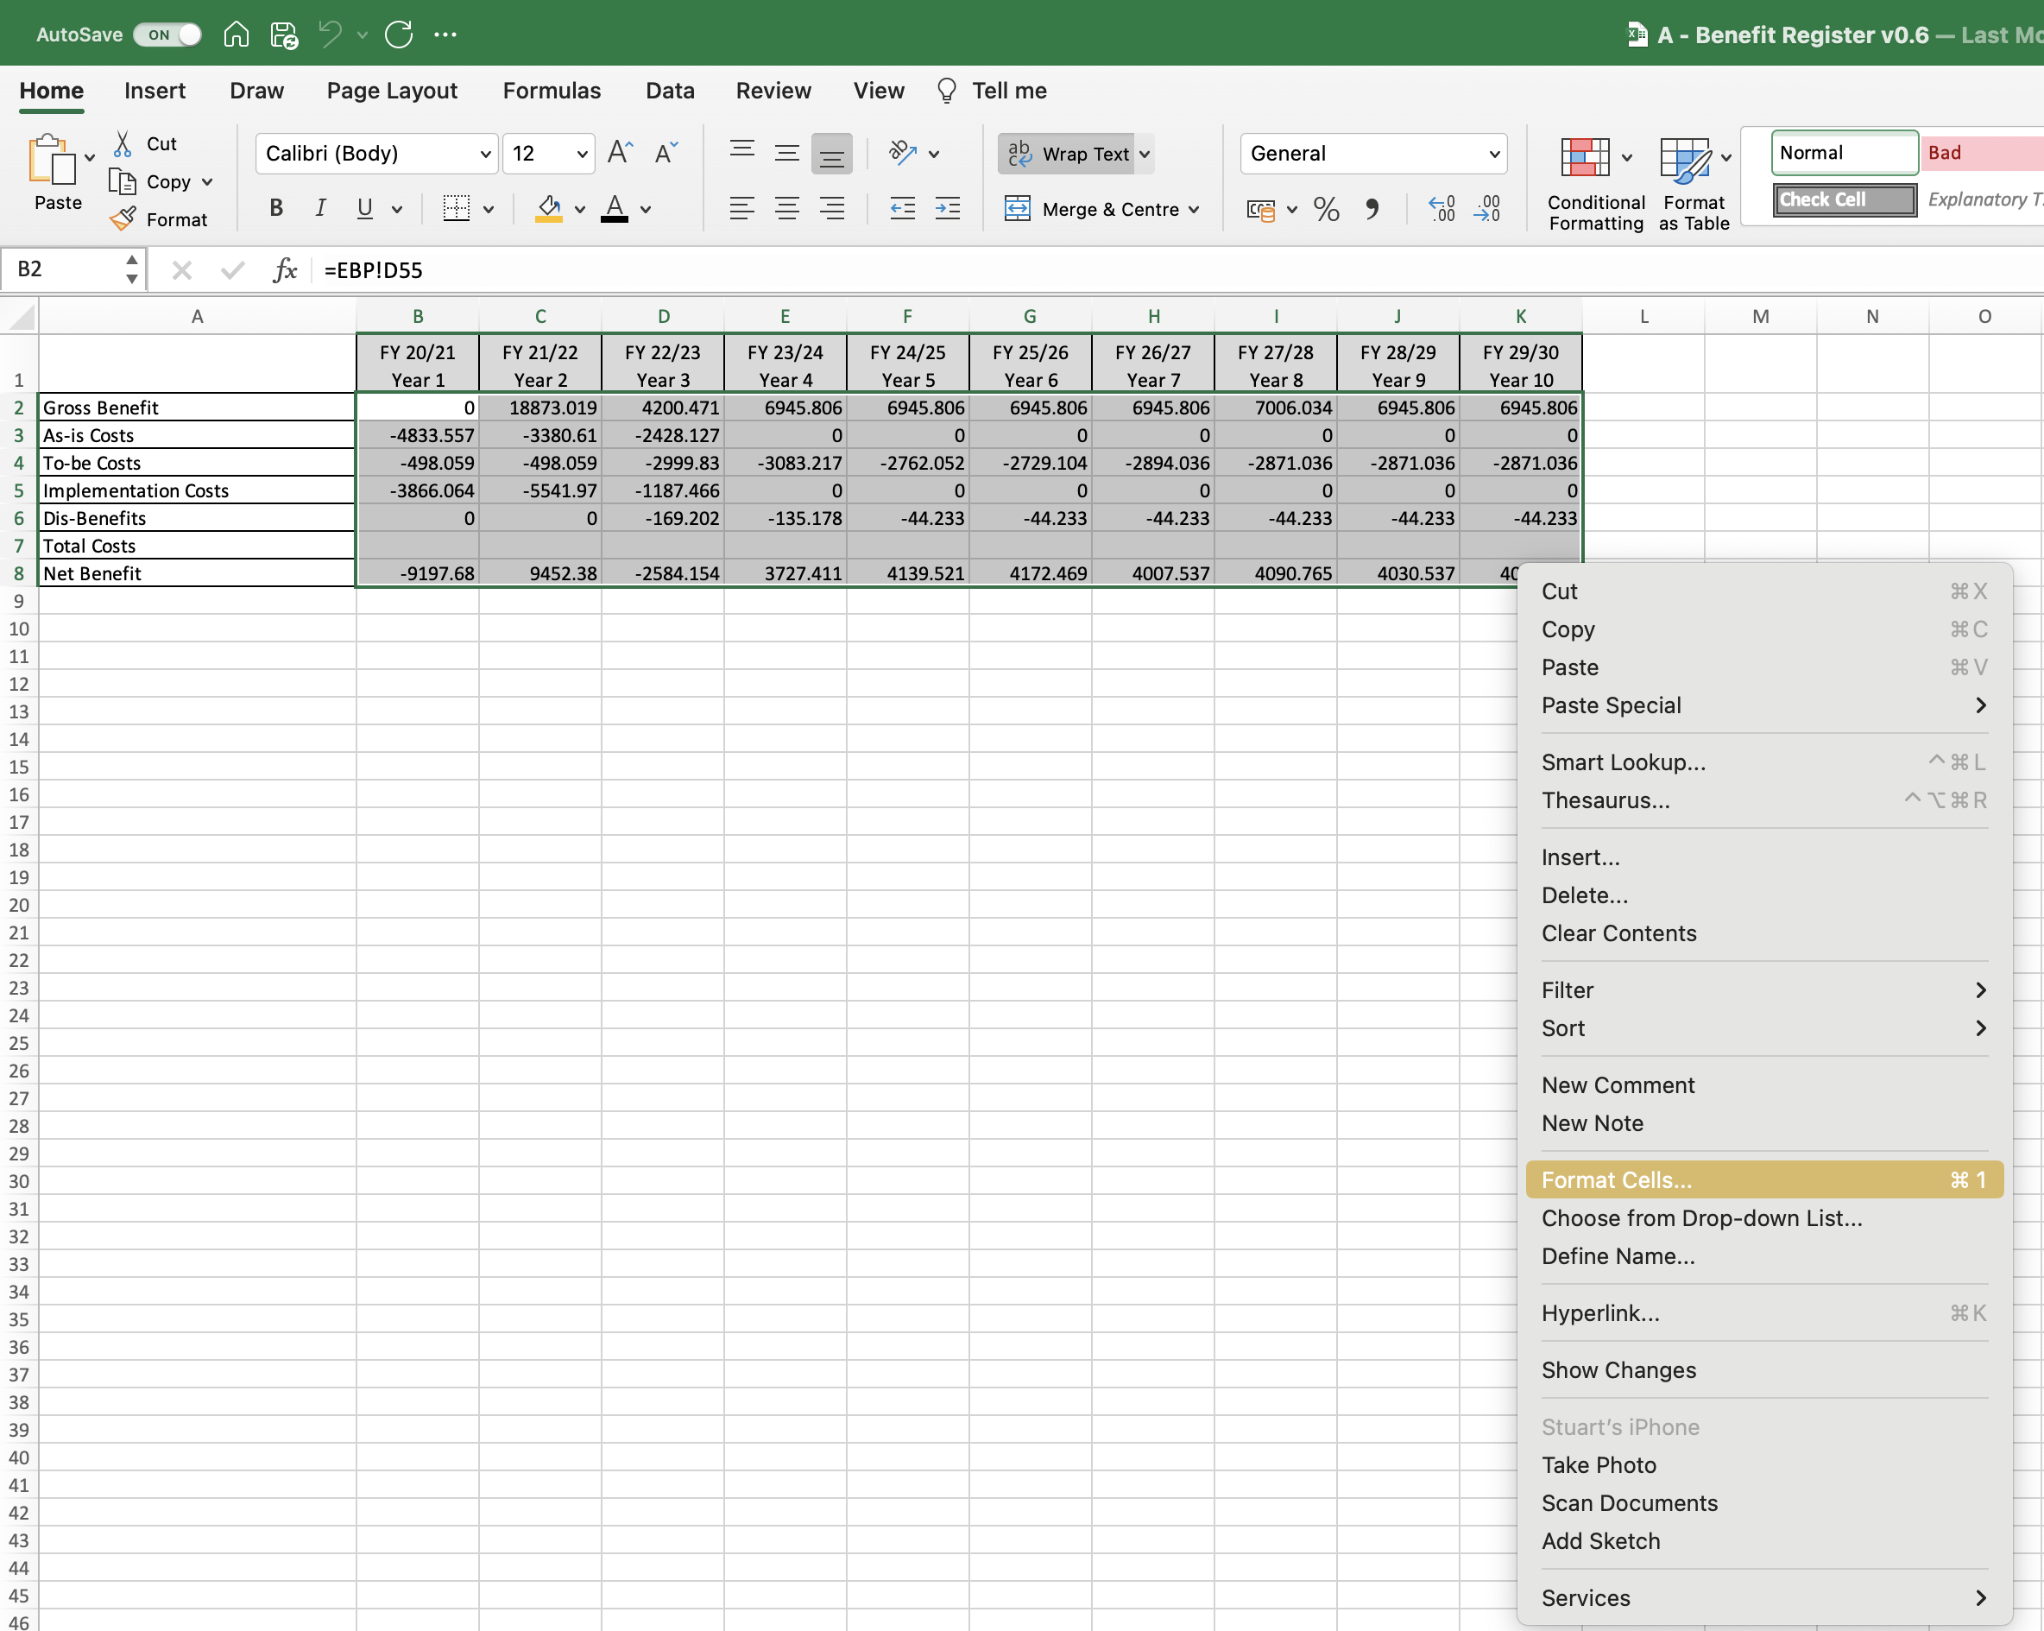
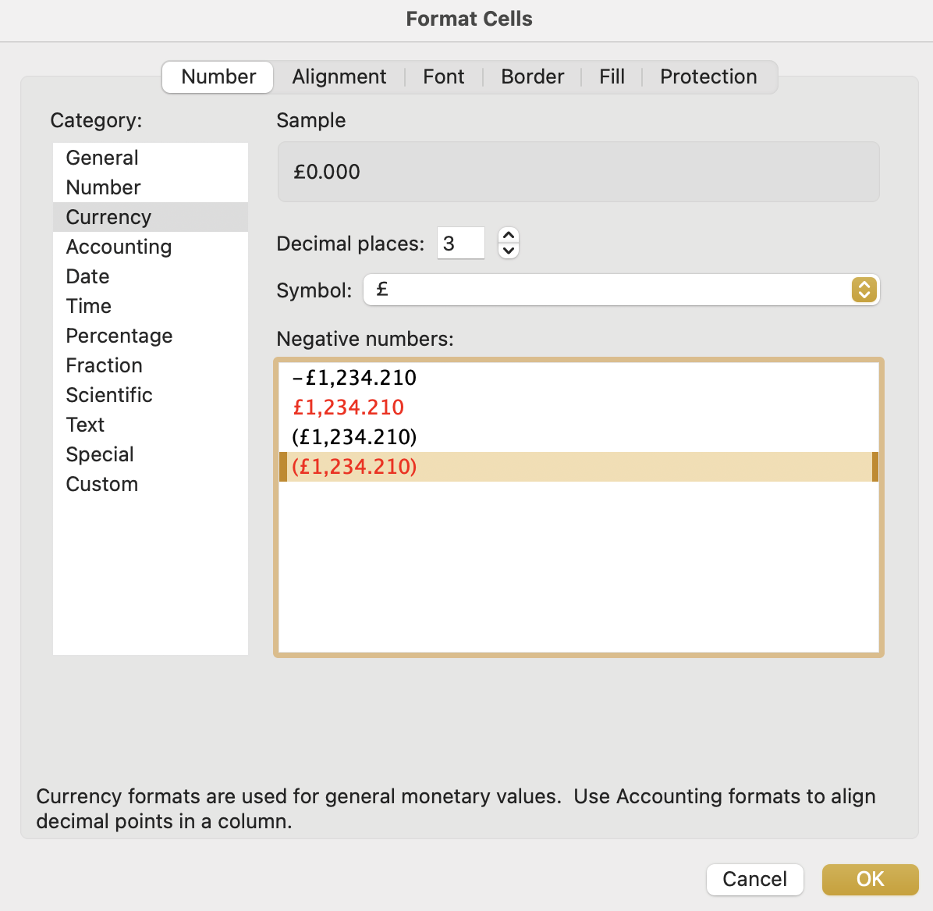
Image 70
2
The ‘Format Cells’ window will appear. Select (a) Currency (b) 3 Decimal Places (c) £ Symbol (d) 4th option for Negative Numbers (e) OK.
b
a
c
Now we want to format the fields shown. Select all of them, right click, then select ‘Format Cells’.
d
1
e

