Slide 1
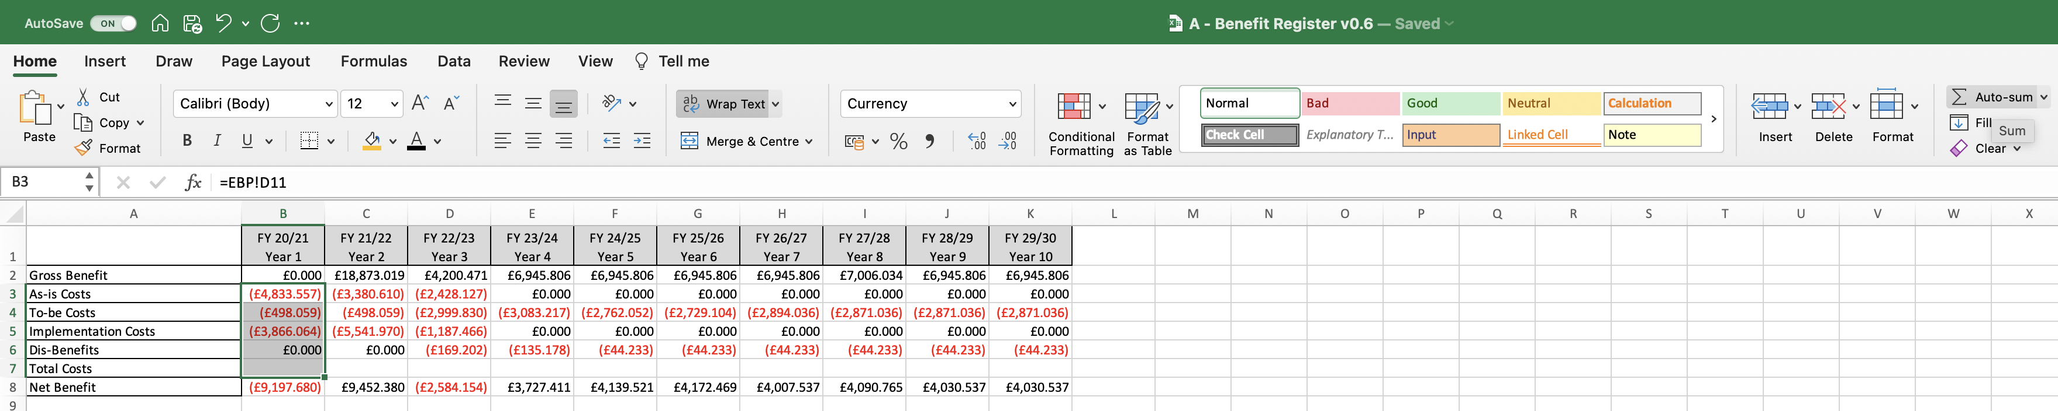
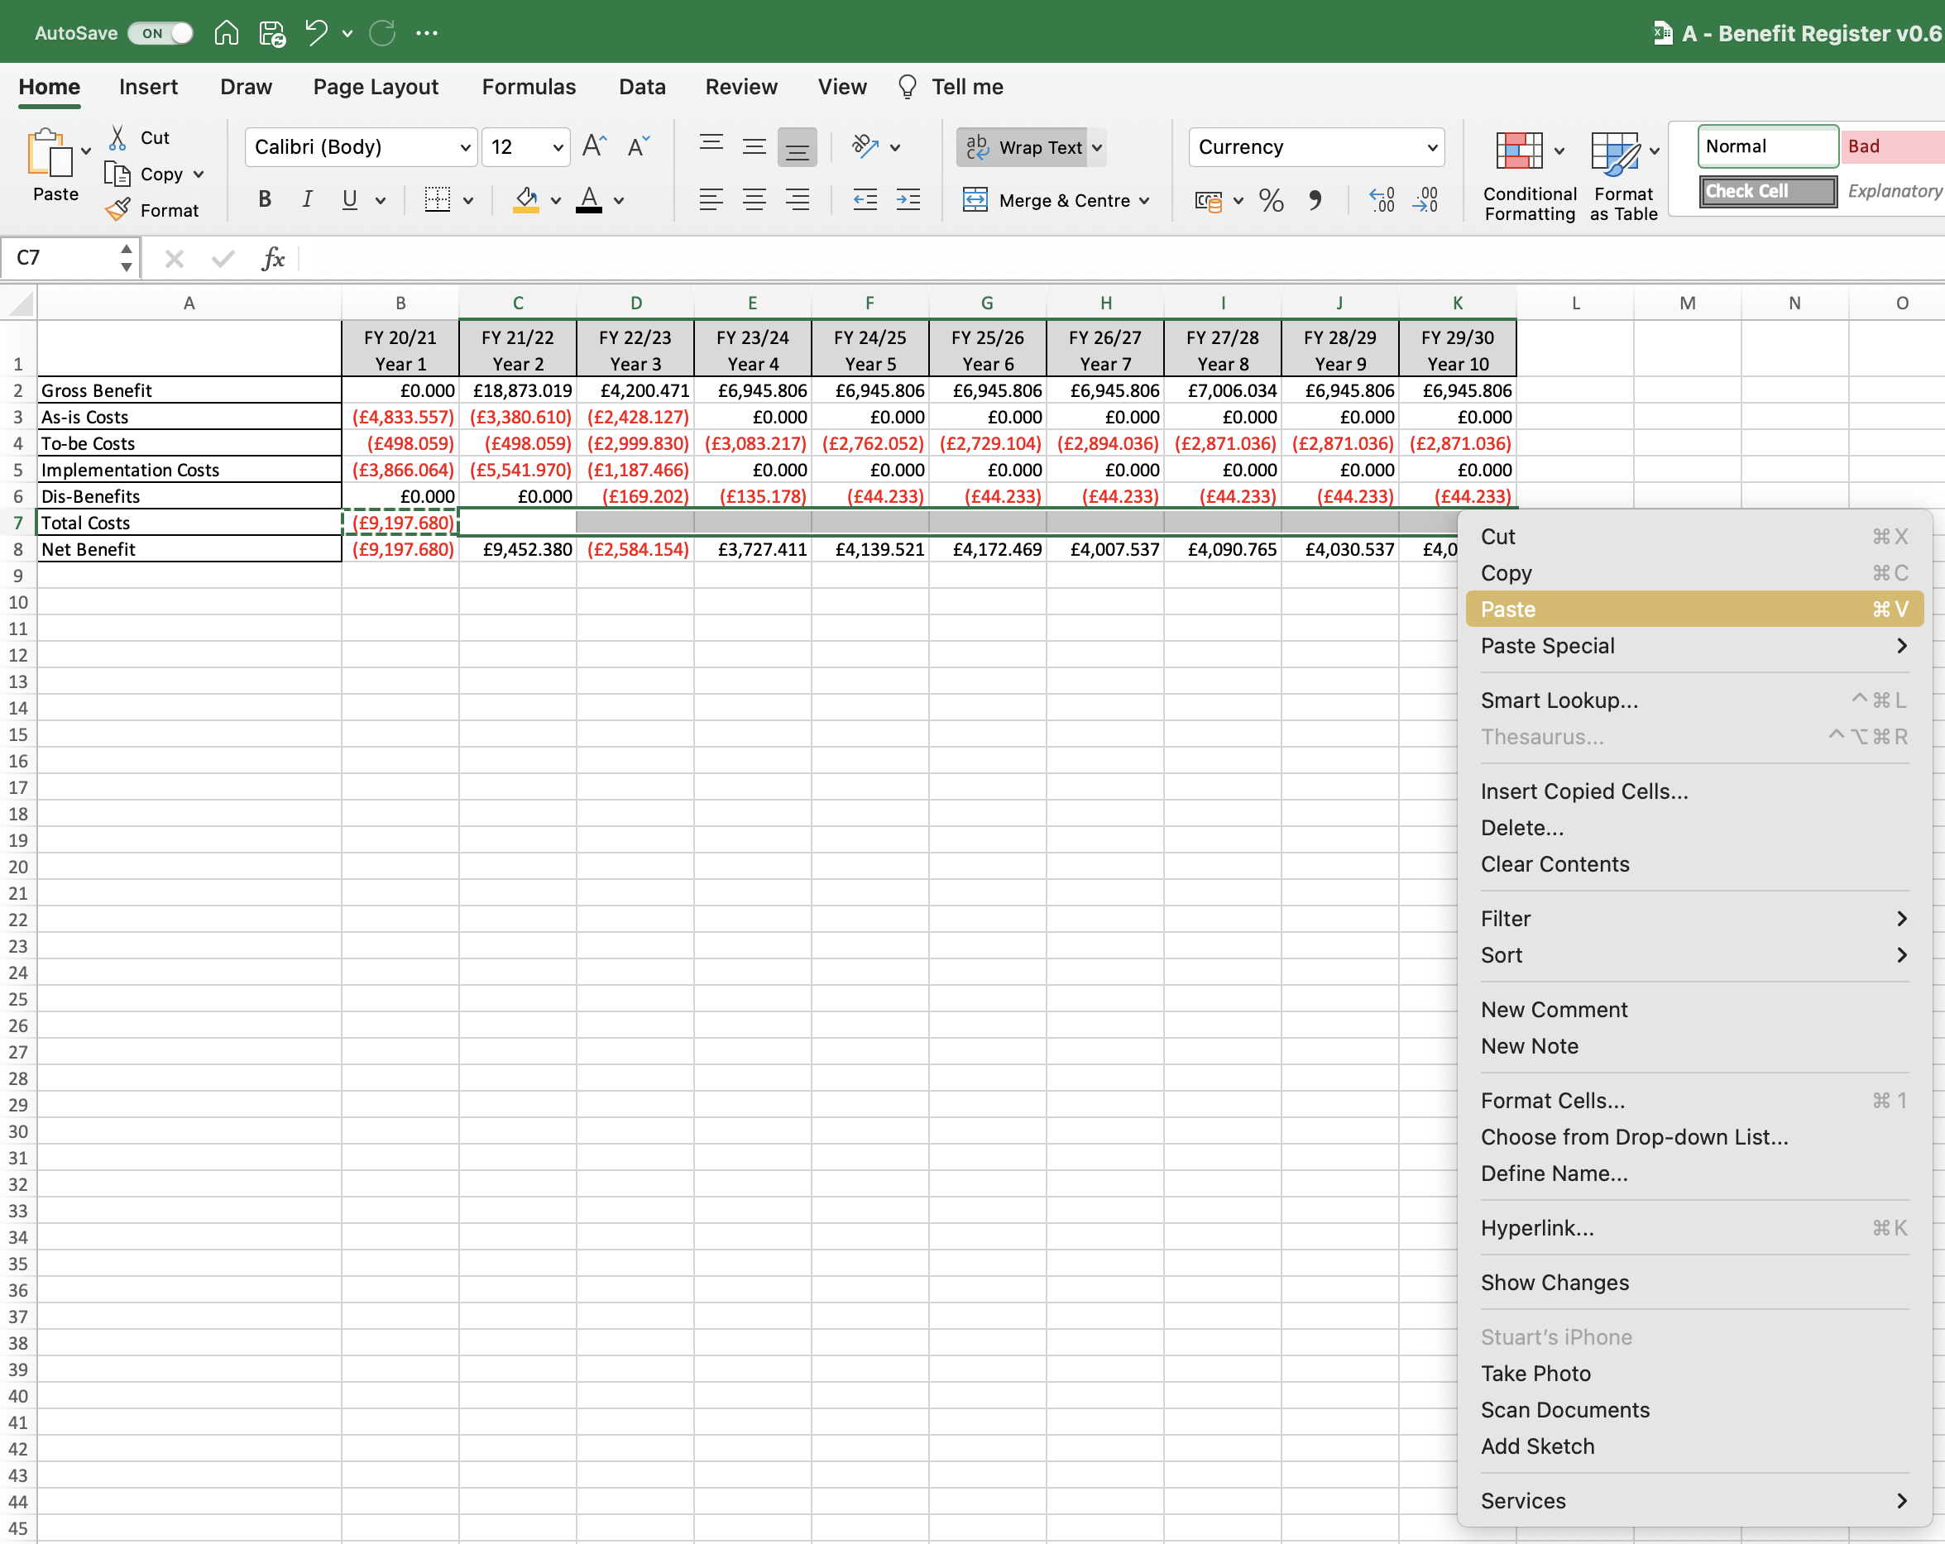
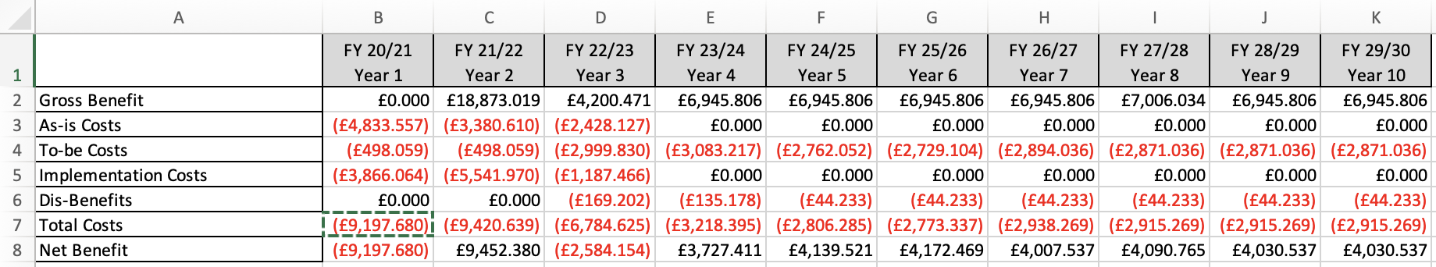
Image 71
Next, right click on field ‘B7’, then select ‘copy’.
b
2
a
Populate the ‘Total Costs’ field ‘B7’ for year 1 by doing this: (a) select the 5 cost related fields as shown (b) select ‘Auto-sum’.
1
Select fields ‘C7-K7’; right click on any one of them; select paste.
4
The data table should now look like this.
3

