Slide 1
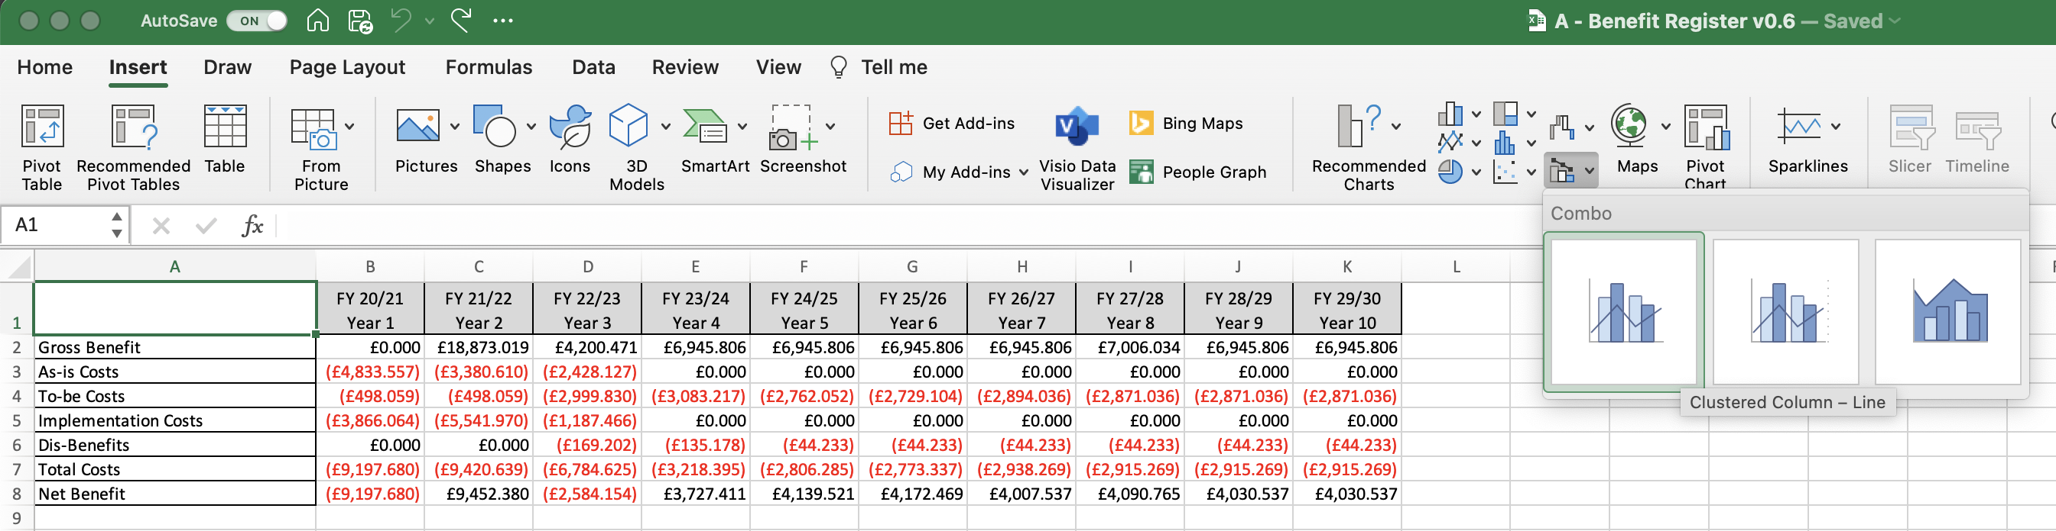
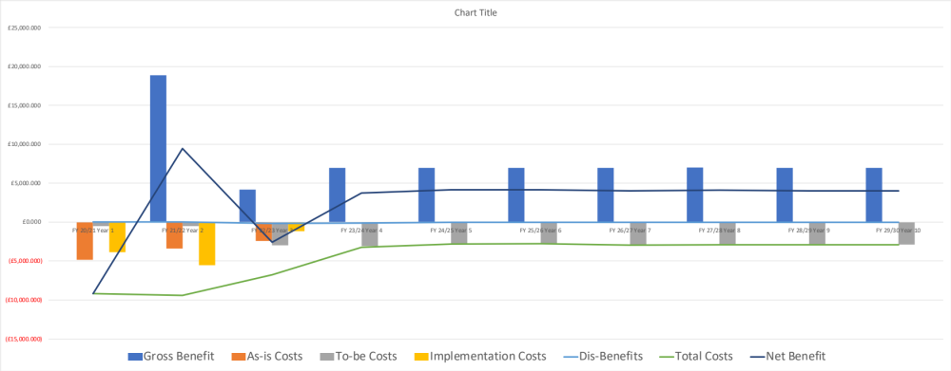
Image 72
3
Select the ‘Combo’ chart icon.
2
Select the ‘Insert’ TAB.
1
Edit field ‘A1’.
4
Select this ‘Combo’ chart.
The Combination Chart will drop into your view. Drag any one of the 4 corners to enlarge the image.
5

