Slide 1
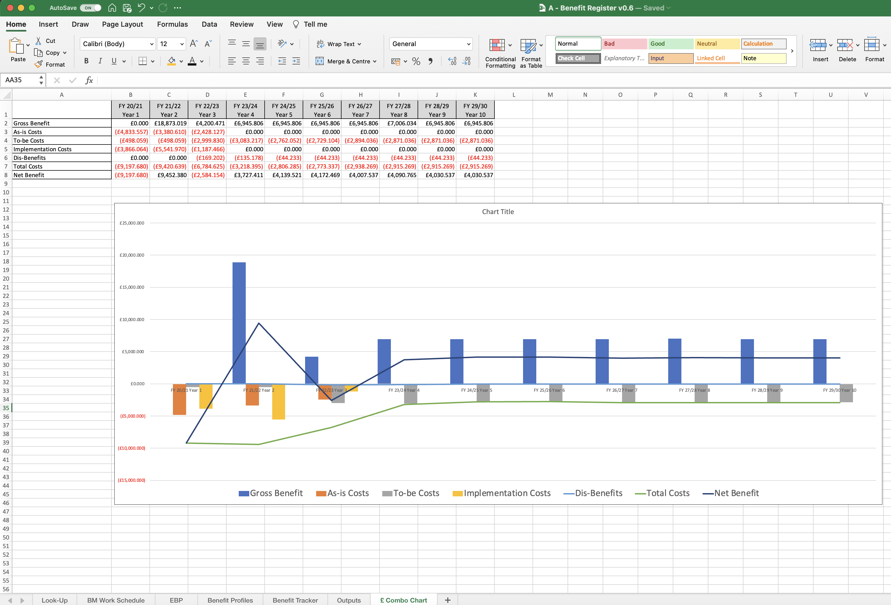
Image 73
3
Increase the size of the ‘font’ of the key, so you can see it at the bottom easily.
1
Select the ‘Home’ TAB.
4
Remove the following elements from this Combination Chart:
As-is Costs
To-be Costs
Implementation Costs
Dis Benefits
You can do that as follows:
Right click onto any of the ‘as-is’ costs amber bars, when the next window opens, select ‘delete’.
Complete same action for the ‘implementation’ costs (yellow bars) and ‘to-be’ costs (grey bars).
Right click onto the light blue Dis-Benefit line in the chart (you can see it running along the bottom axis (see blue arrow in the chart to help you), then select ‘delete’.
Dis-Benefit line.
2
Select anywhere on the ‘Key’ to highlight it.

