Slide 1
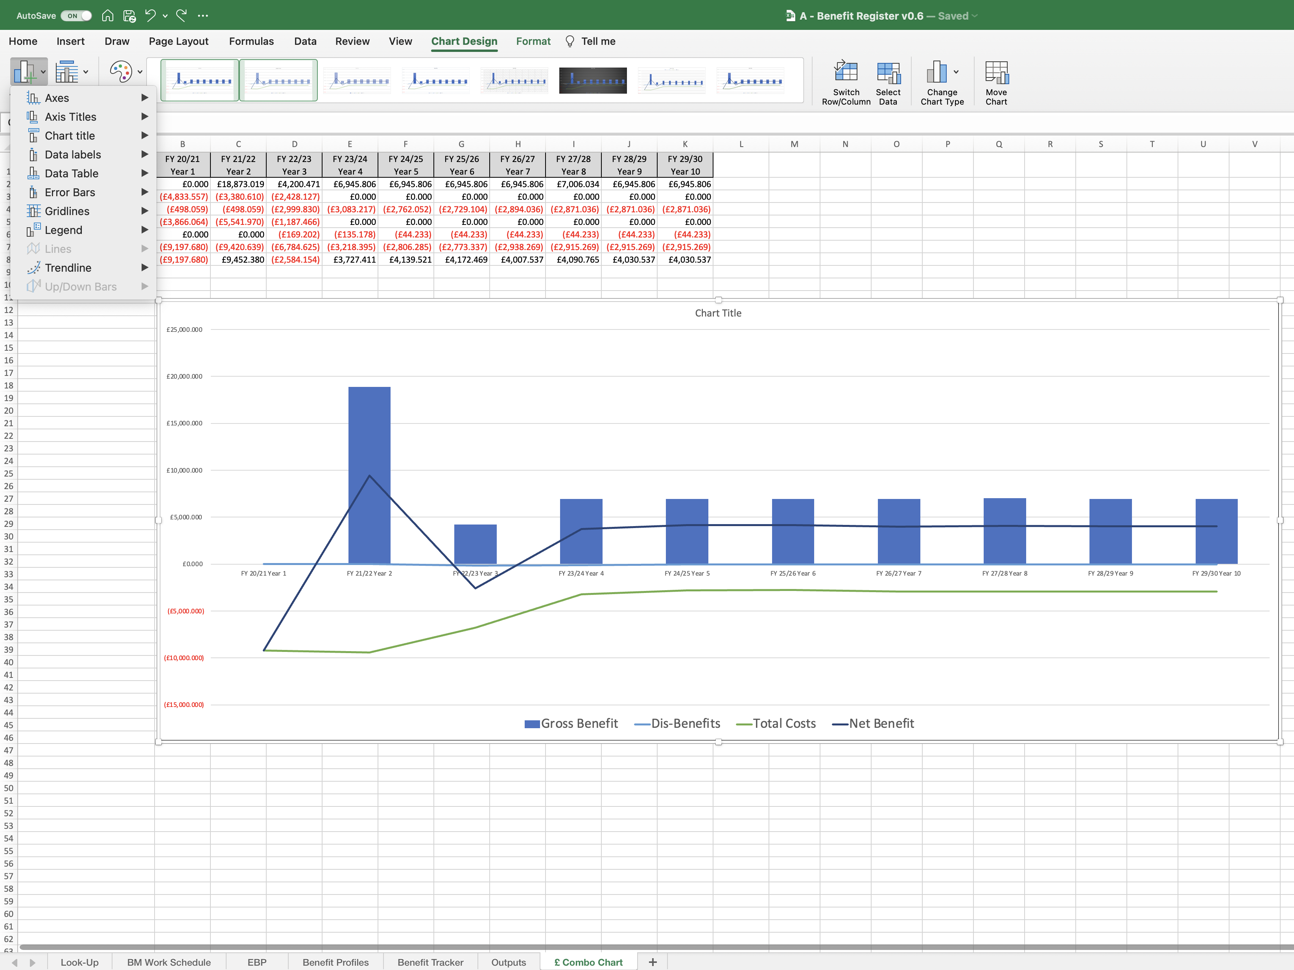
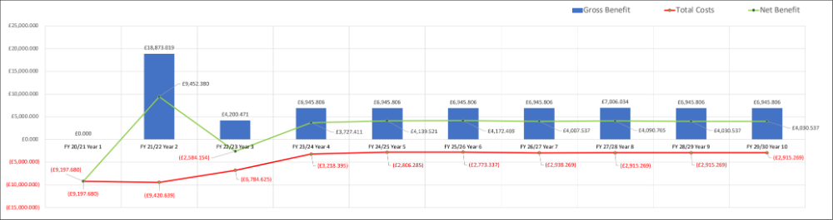
Image 74
3
Excel will take you to the ‘Chart Design’ TAB.
4
Select the ‘Add Chart Element’.
5
When this window appears, exploit the options and practice what you have learnt so far, to make the Combination Chart look like this one below.
Click anywhere in the chart on the white space.
2
1
The Combination Chart now looks like this.
Tip: You can right click on the lines to change the colour (select ‘Format Data Series’ then use the ‘paint bucket’ to find the desired colour).
The Combination Chart has been moved to the end of the worksheets.

