Slide 1
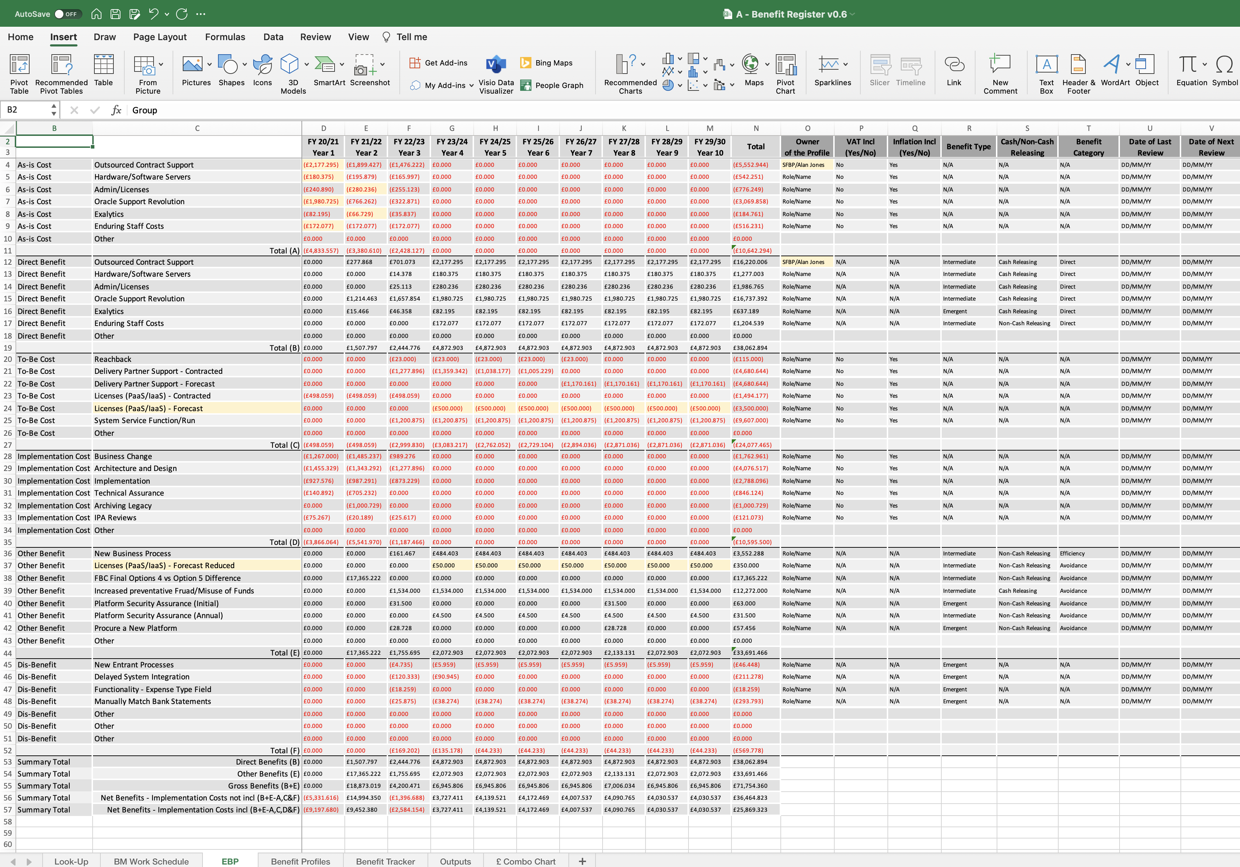
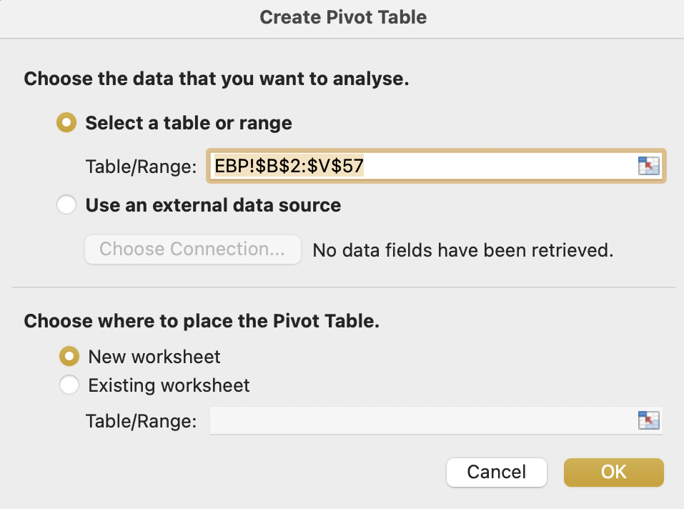
Image 77
Select the ‘Insert’ tab.
2
You are now going to create the first of two PivotTables.
3
Select ‘PivotTable’.
You are looking at the EBP worksheet in the Benefit Register. Edit any field within the data table.
1
The ‘Create PivotTable’ window will appear and be pre-populated. Ensure ‘New worksheet’ is selected, then Select ‘OK’.
4

