Slide 1
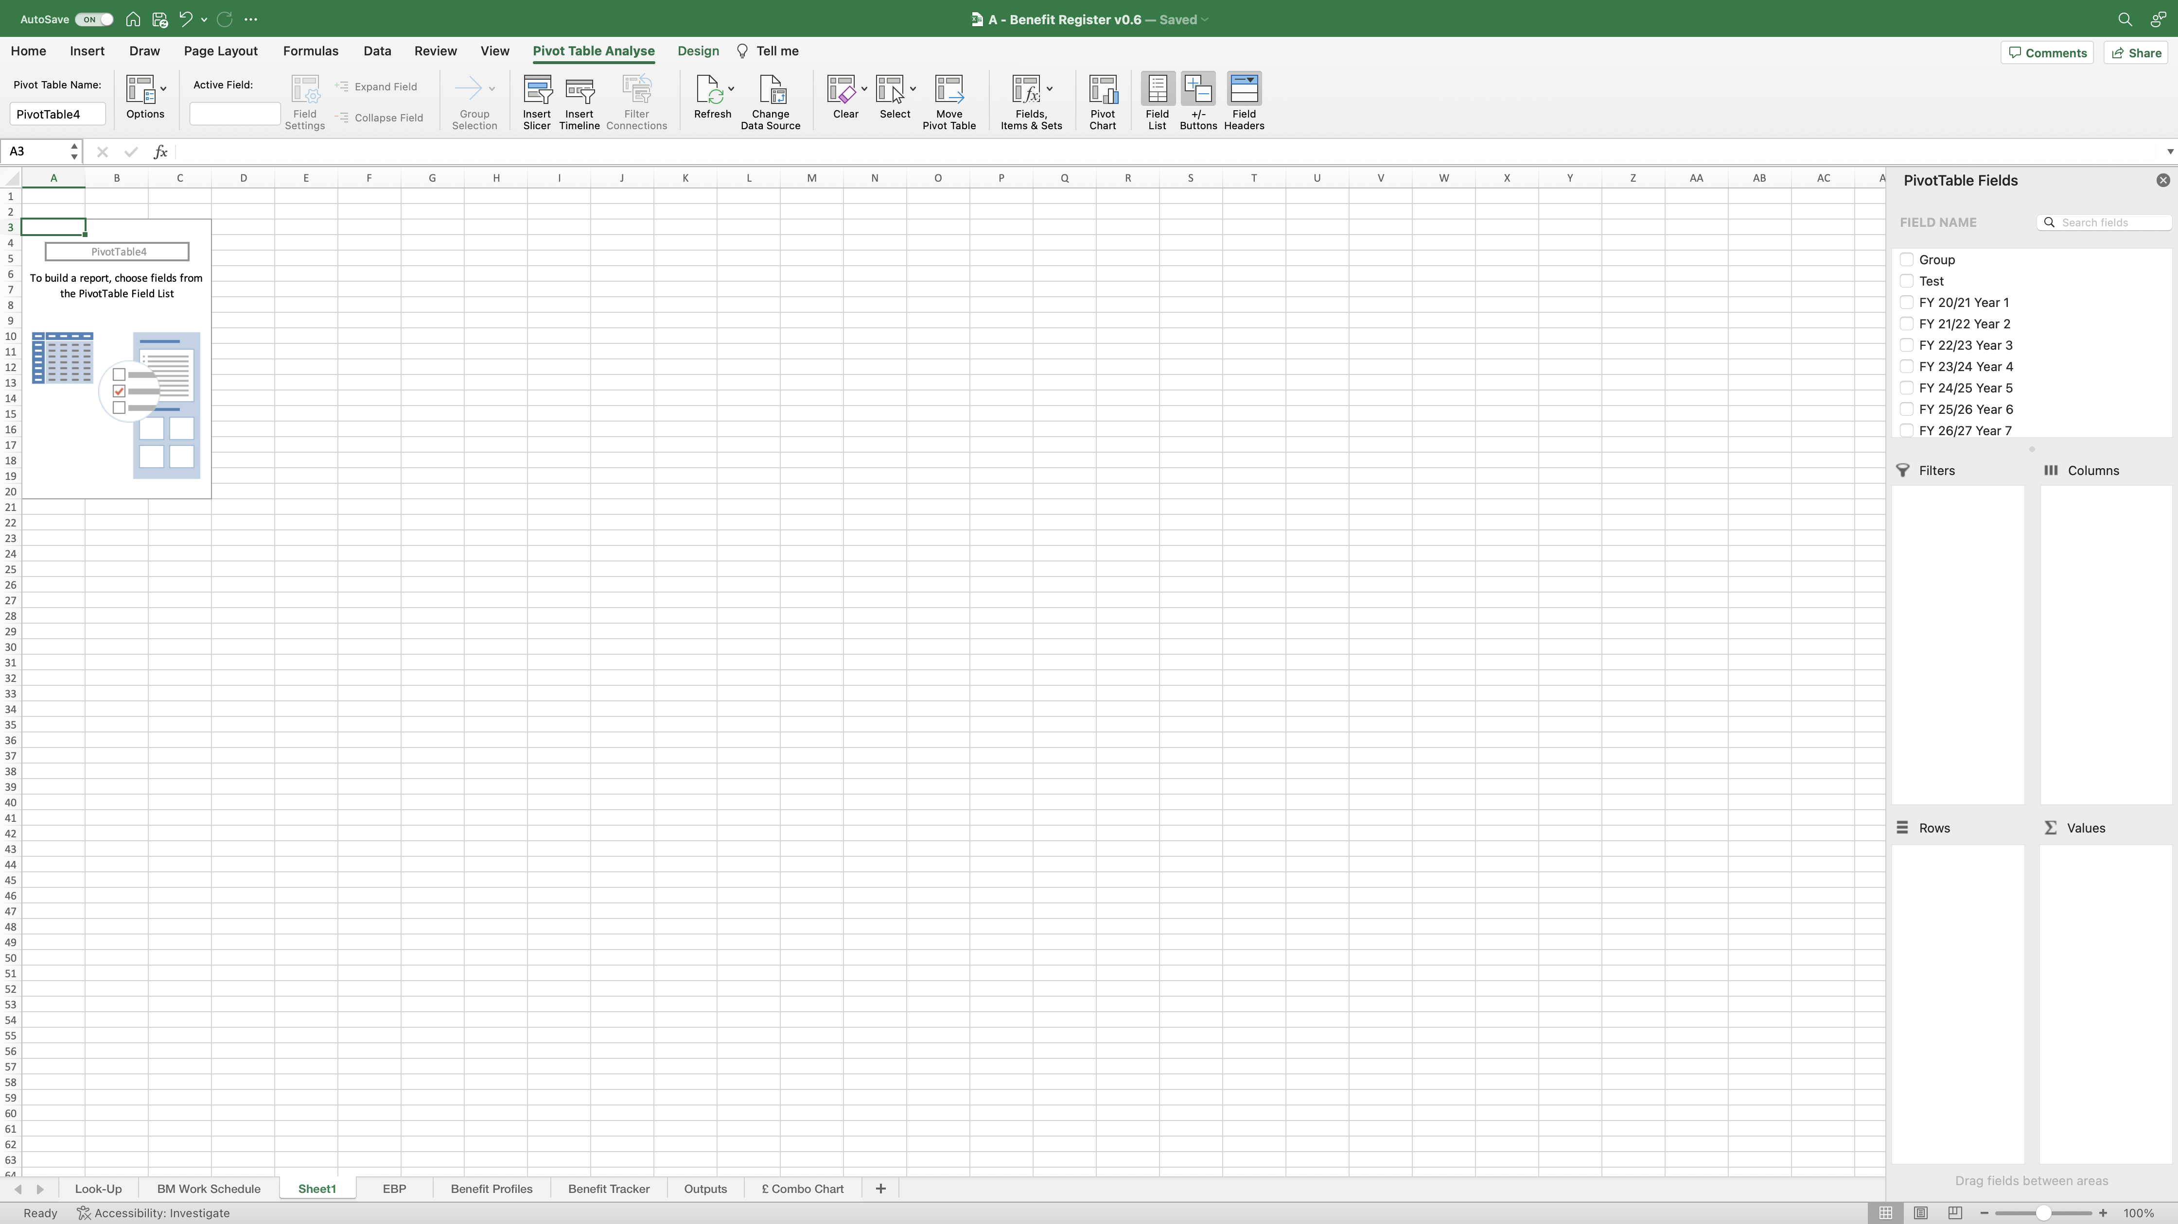
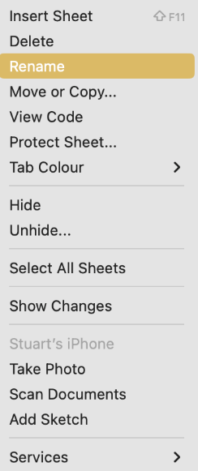
Image 78
Tip. Edit this field to open the ‘PivotTable Fields’ on the right of the screen.
Rename the worksheet ‘£ Intermediate-Emergent’. When complete, move the new worksheet to the end as seen above. You can do this by clicking/holding on the worksheet name, then dragging it to the desired position.
3
When inserting a new PivotTable into its own worksheet, you will see this screen; Excel created this new worksheet and called it ‘Sheet1’.
1
2
Right click on the worksheet name ‘Sheet1’. The window on the right will appear. Select ‘Rename’.

