Slide 1
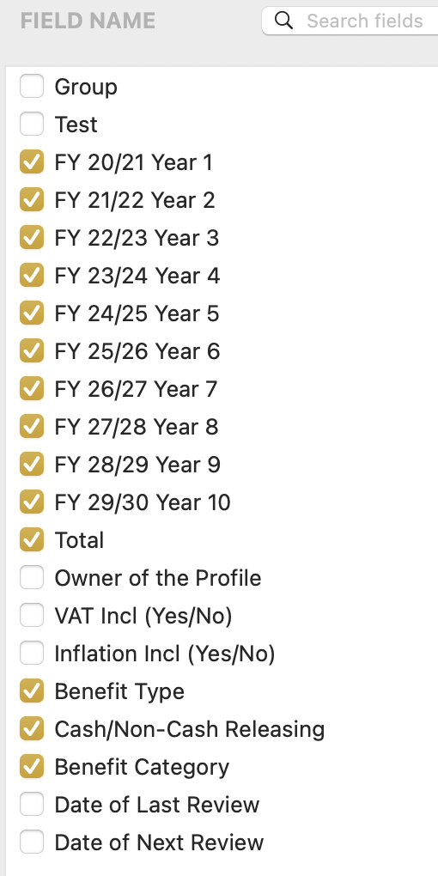
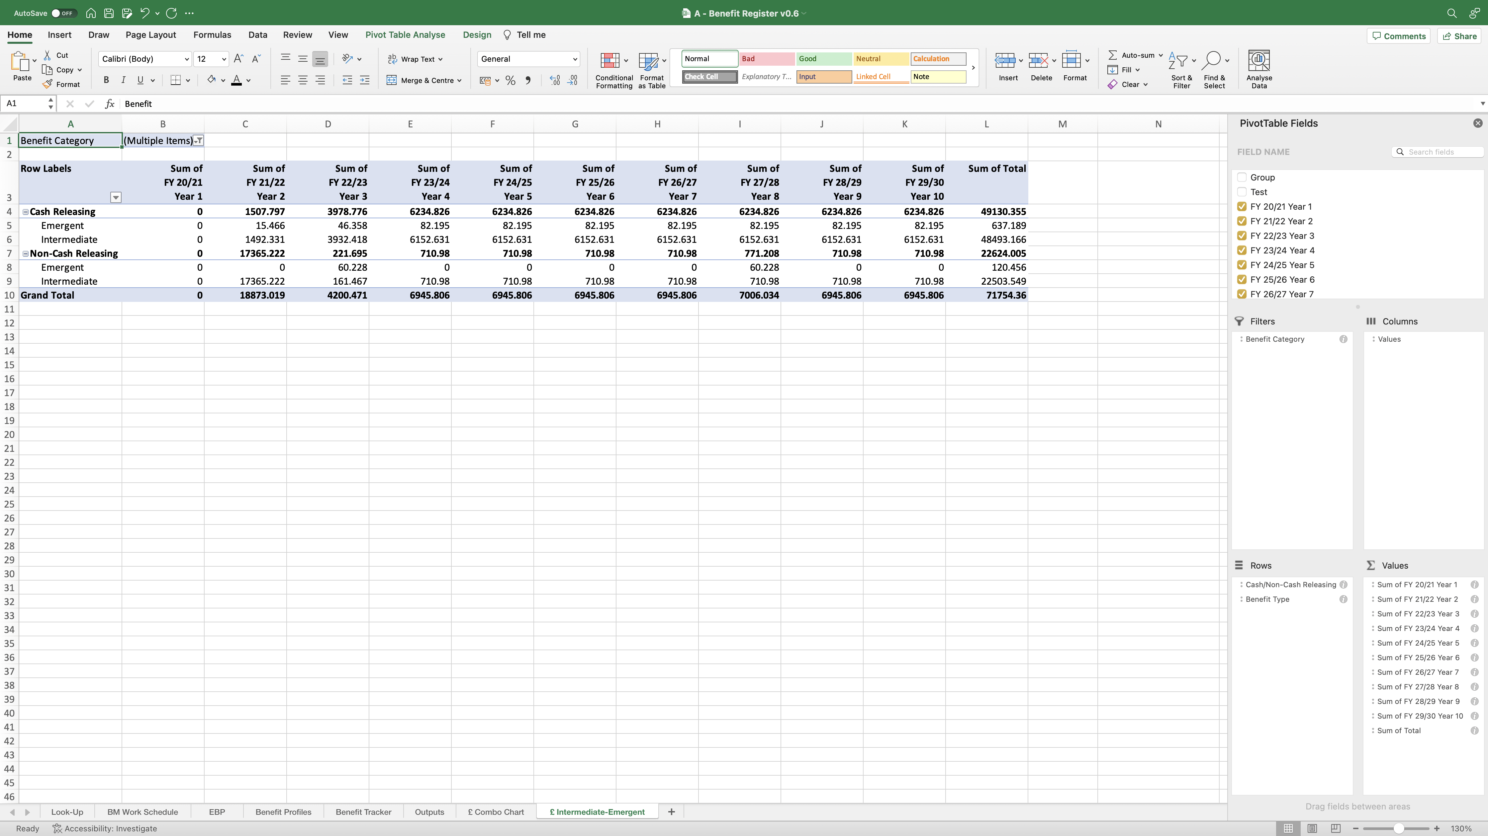
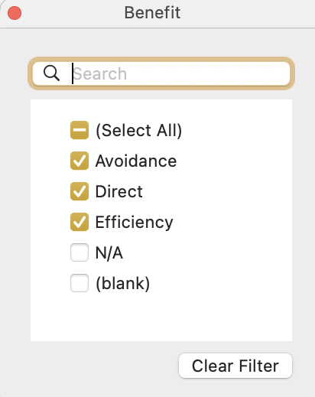
Image 79
2
Select the drop-down icon, when this window appears, de-select the ‘N/A’ and ‘(blanks)’ fields.
Drag and drop the highlighted field names from the ‘Field Name’ group at the top, into the ‘Filters, Rows and Values’ fields at the bottom as shown.
When complete, the field names ‘FY 20/21 Year 1–FY 29/30 Year 10’ and ‘Total’, auto populate with the additional text ‘Sum of’, when they have been dropped into the ‘Values’ field. Allow that to happen – do nothing.
1

