Slide 1
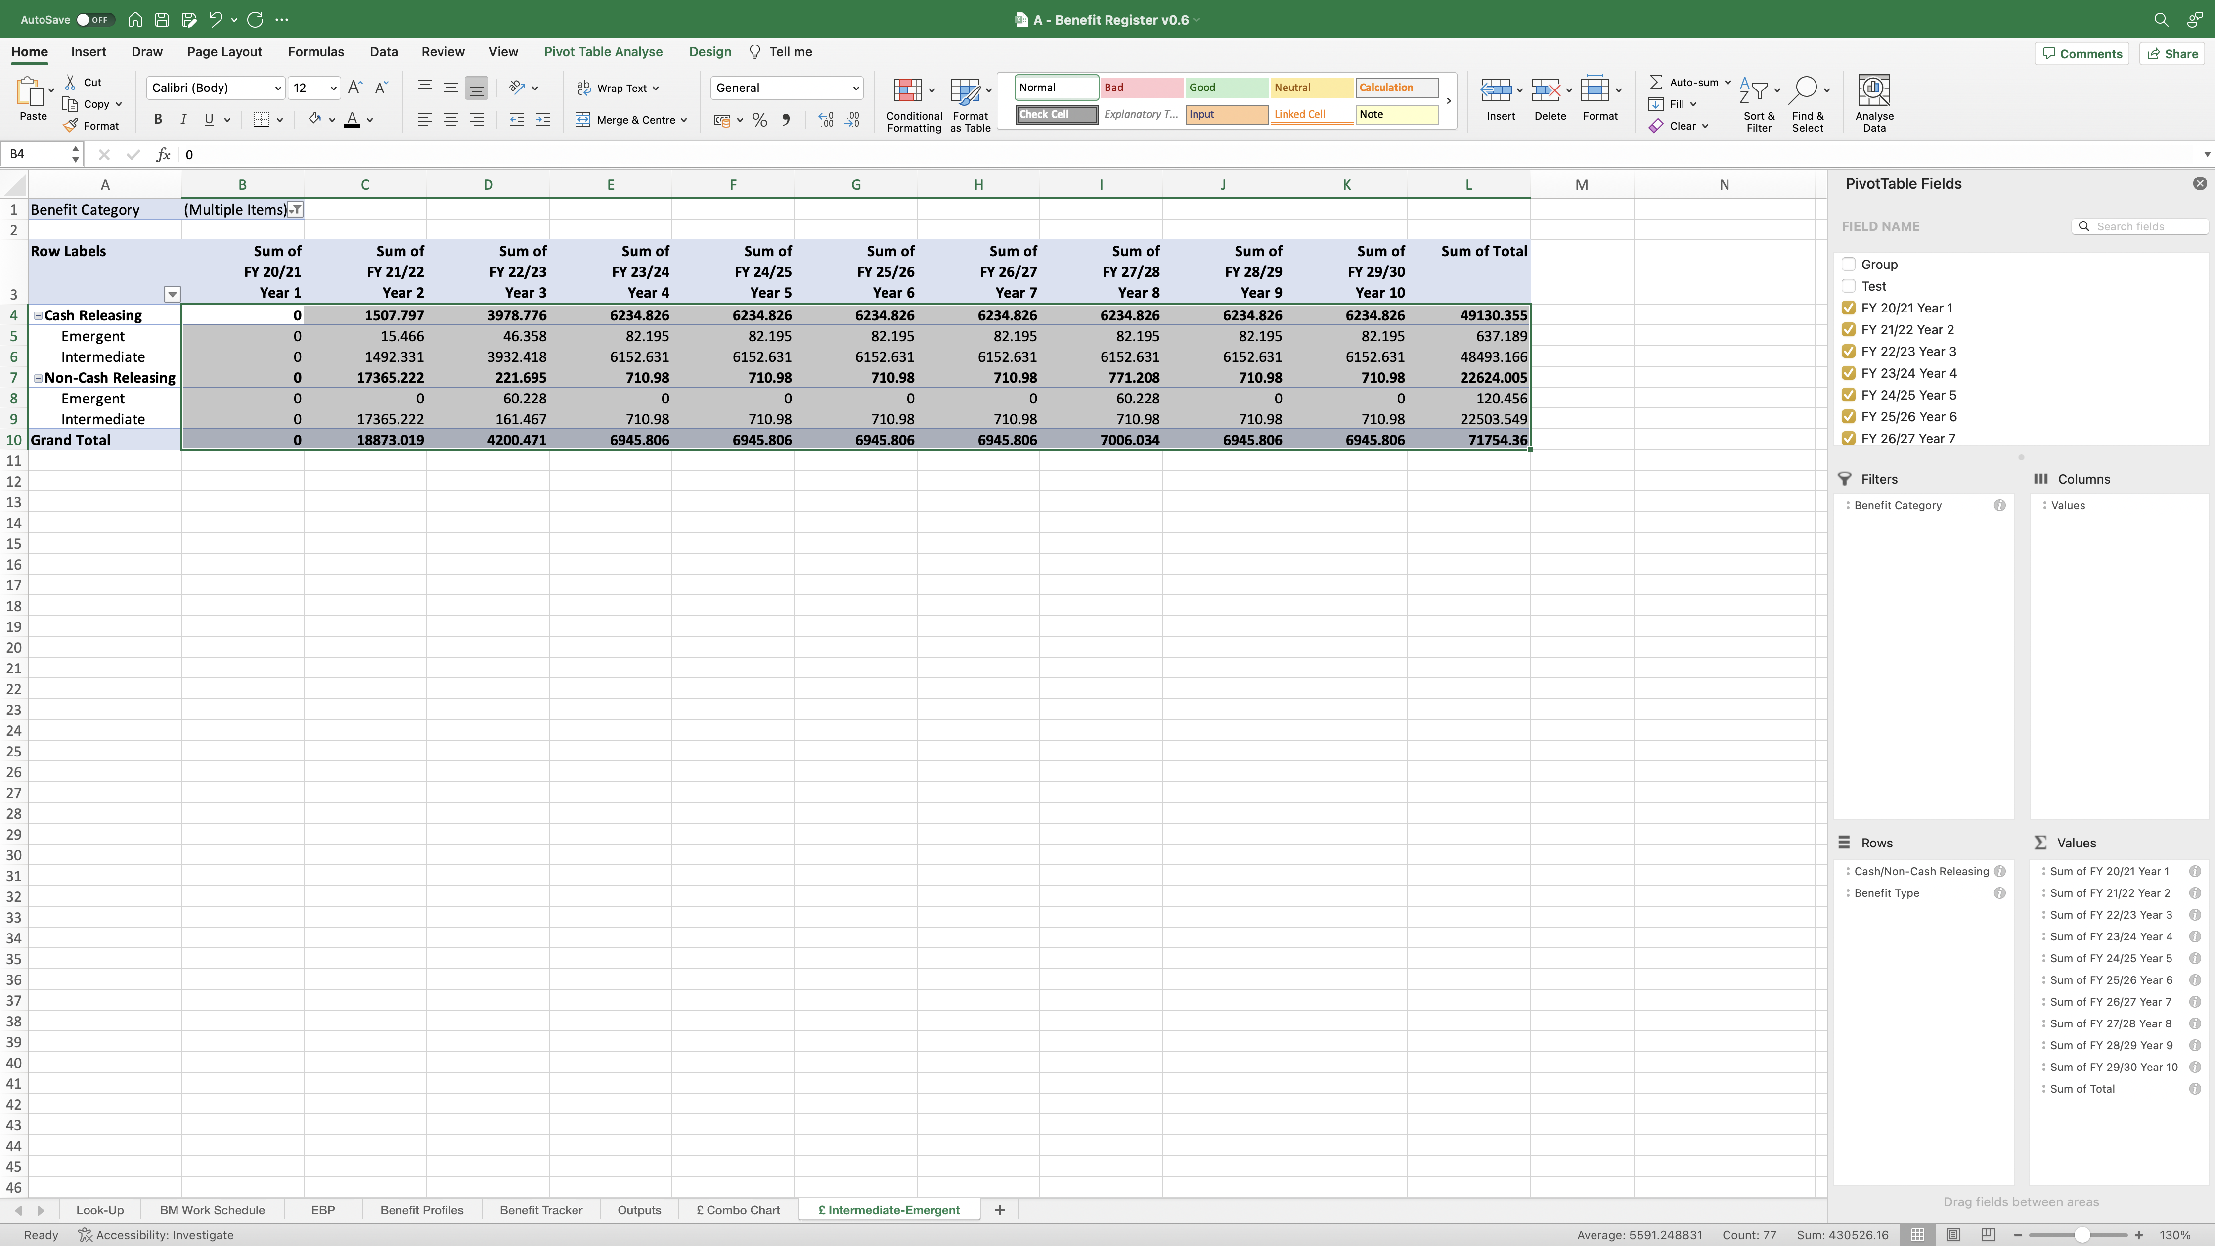
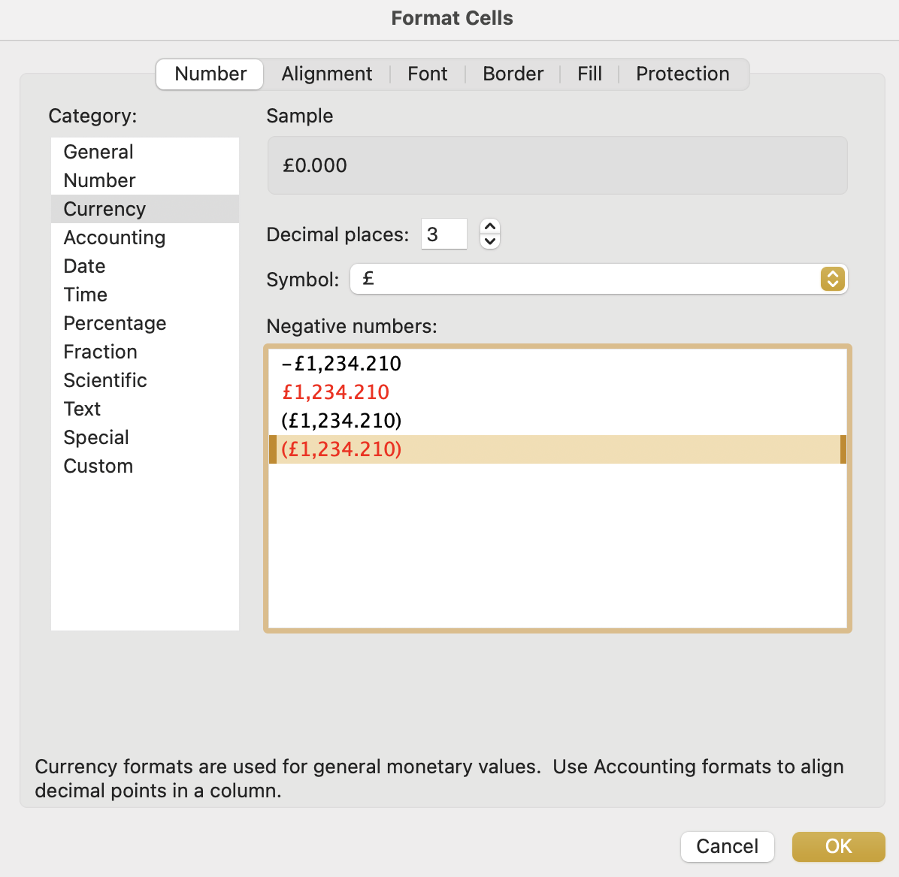
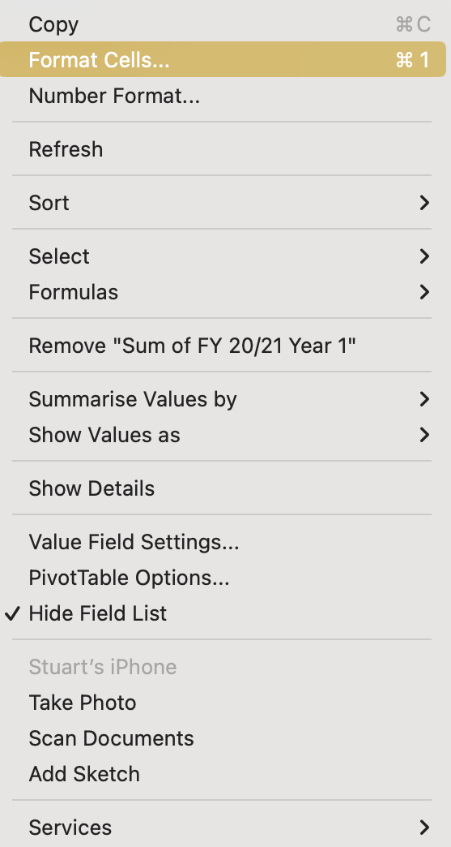
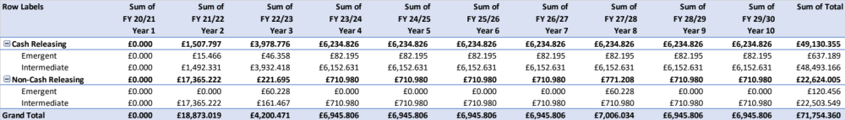
Image 80
The ‘Format Cells’ window will appear. Select (a) ‘Currency’ (b) ‘3 Decimal Places’ (c) ‘£ Symbol’ (d) ‘4th option for Negative Numbers’ (e) ‘OK’.
2
Now we want to format these fields. Select all of them as shown, right click on any of them, then select ‘Format Cells’.
1
b
a
c
When complete, the table should look like this. See tips, to help tidy up the PivotTable, at image 82.
d
3
e

