Slide 1
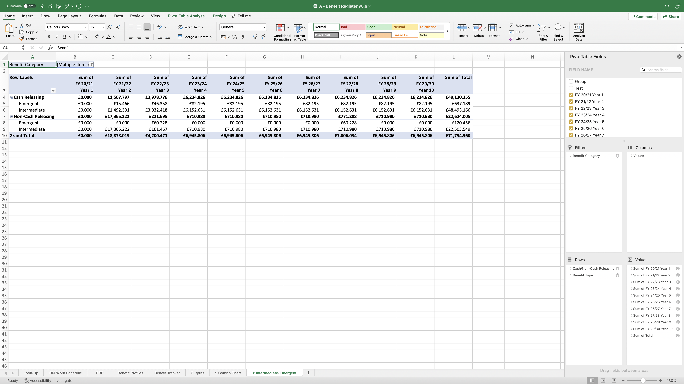
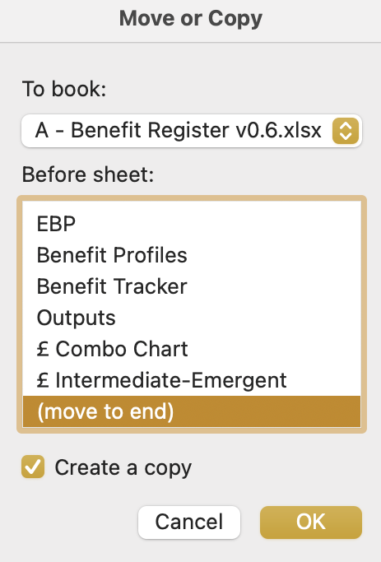
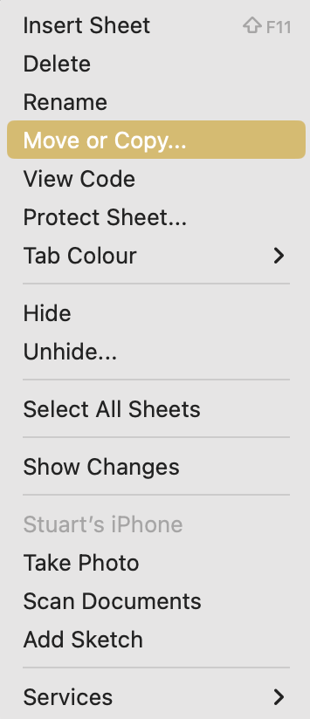
Image 81
You are now going to create the second PivotTable.
Right click on the ‘£ Intermediate-Emergent’ worksheet name, then select ‘Move or Copy’ when the window opens.
1
When the ‘Move or Copy’ window opens, scroll down the first box to find and select ‘(move to end)’. Select ‘Create a copy’. Select ‘OK’.
2

