Slide 1
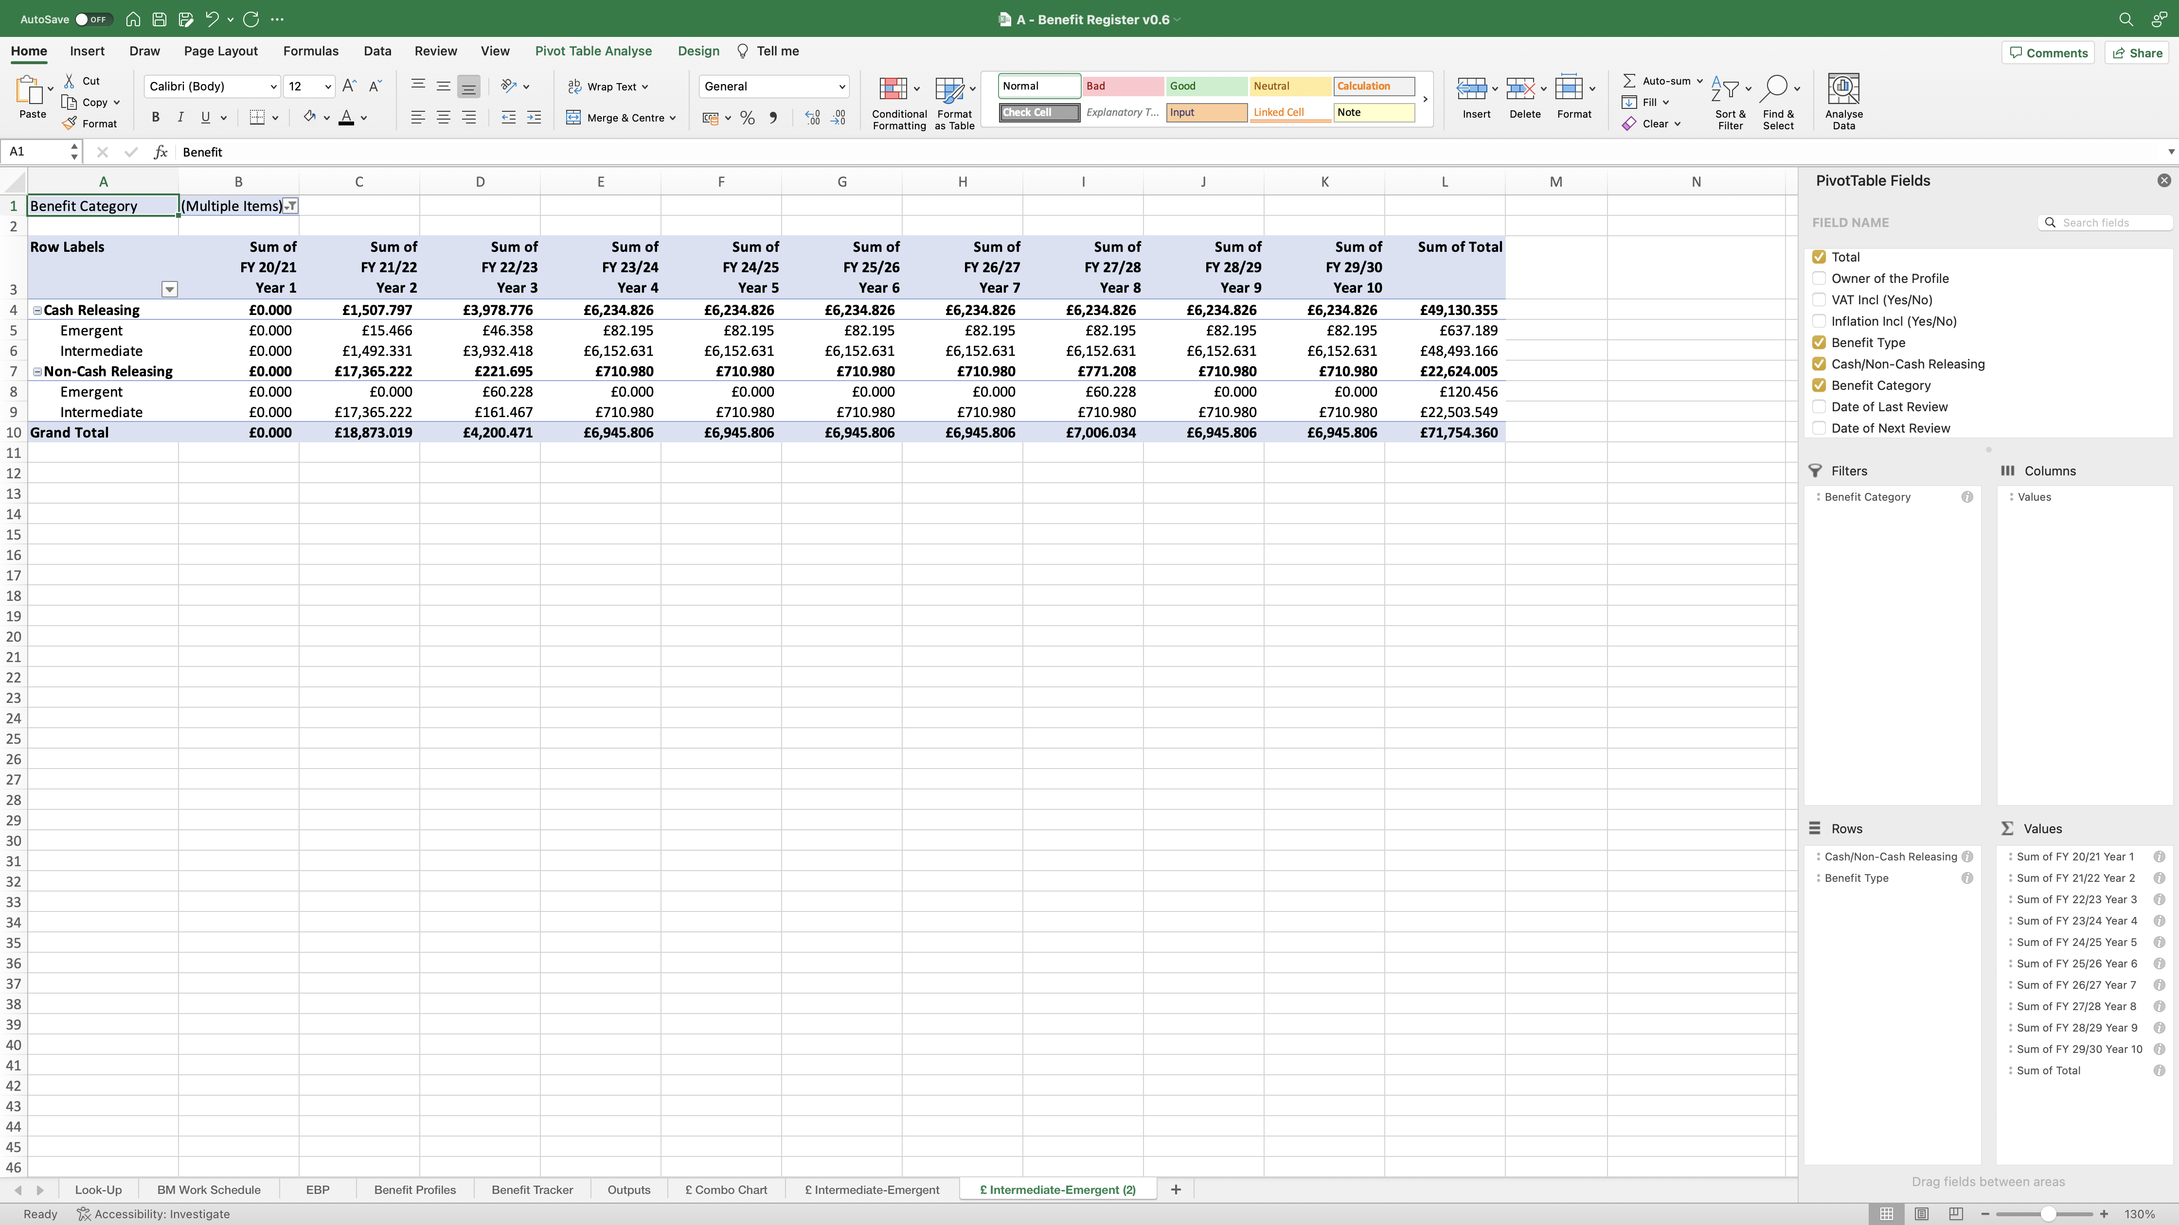
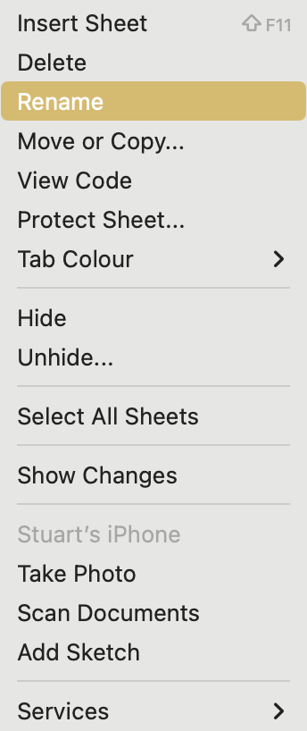
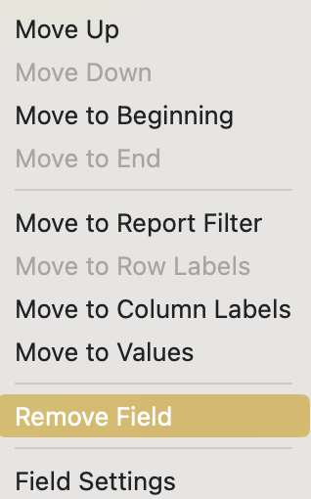
Image 82
Tip: Highlight the columns together, then drag the line between the letters to increase/decrease the width of the columns. This makes the PivotTable look presentable.
Tip: These labels can be moved into a different order by right clicking on them to select ‘Move’. This will change how they appear in the PivotTable.
3
Drag the ‘Benefit Category’ field down from ‘Filters’ and drop it into ‘Rows’ underneath the ‘Cash/Non-Cash Releasing’ field.
Tip: When highlighting the column headings, right click to select ‘Format Cells’ to help tidy them up. For example, you can ‘Wrap’ the text.
Tip: These fields can be moved into a different order by ‘click- hold-dragging’ them to the desired location. This will change how they appear in the PivotTable.
Right click on the ‘£ Intermediate-Emergent (2)’ worksheet name, then select ‘Rename’ when the window opens. Rename the worksheet ‘£ Dir-Effic-Avoid’.
1
Right click on the ‘Benefit Type’ field, when the window opens, select ‘Remove Field’.
2

