Slide 1
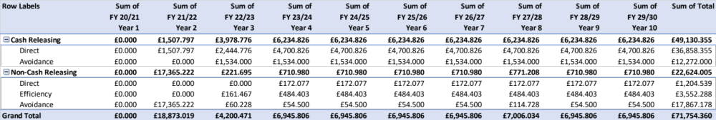
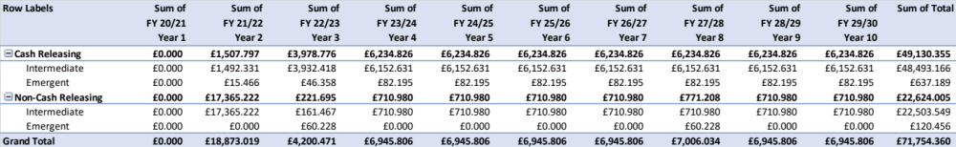
Image 83
The aggregated, low-level Intermediate/Emergent Benefits are used to inform and quantify, the Economic End Benefit on the CI’s Benefit Map. See para 1.1.1.
Gross Direct, Efficiency & Avoidance Benefits that are Cash/Non-Cash Releasing across the life of the CI
End Benefit-02 (Reduced Expenditure): On premise servers removed; fewer contracts; cost optimisation; fewer licences; integration; convergence; monetised time savings; value for money.
FBC Target: £125.6M.
Current value: £71,754.360M.
Gross Intermediate & Emergent Benefits that are Cash/Non-Cash Releasing across the life of the CI
Economic

