Slide 1
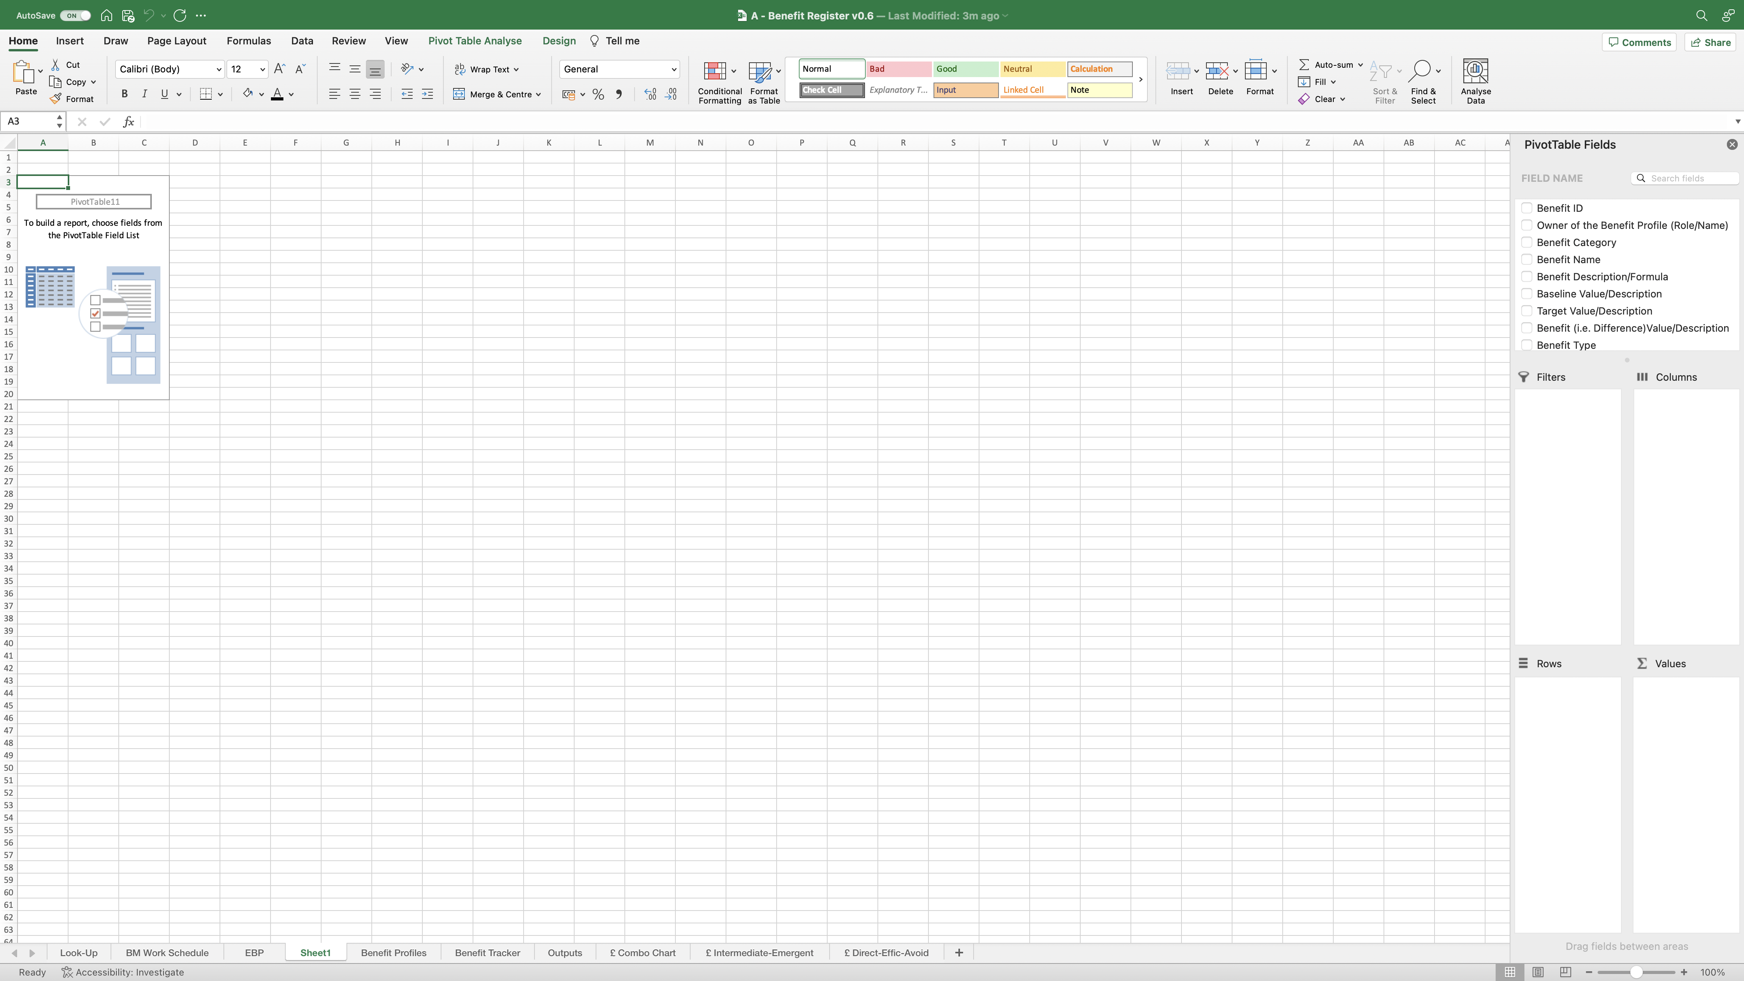
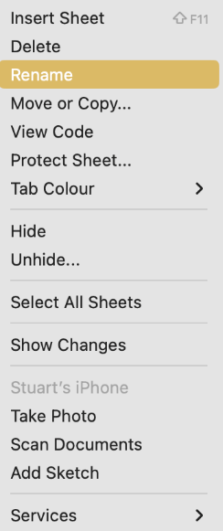
Image 86
Tip. Edit this field to open the ‘PivotTable Fields’ on the right of the screen.
Rename the worksheet ‘Time Savings’. When complete, move the new worksheet to the end as seen above. You can do this by ‘click-hold-dragging’ on the worksheet name to the desired position.
3
When inserting a new pivot table into its own worksheet, you will see this screen; Excel created this new worksheet and called it ‘Sheet1’.
1
2
Right click on the worksheet name ‘Sheet1’. The window on the right will appear. Select ‘Rename’.

