Slide 1
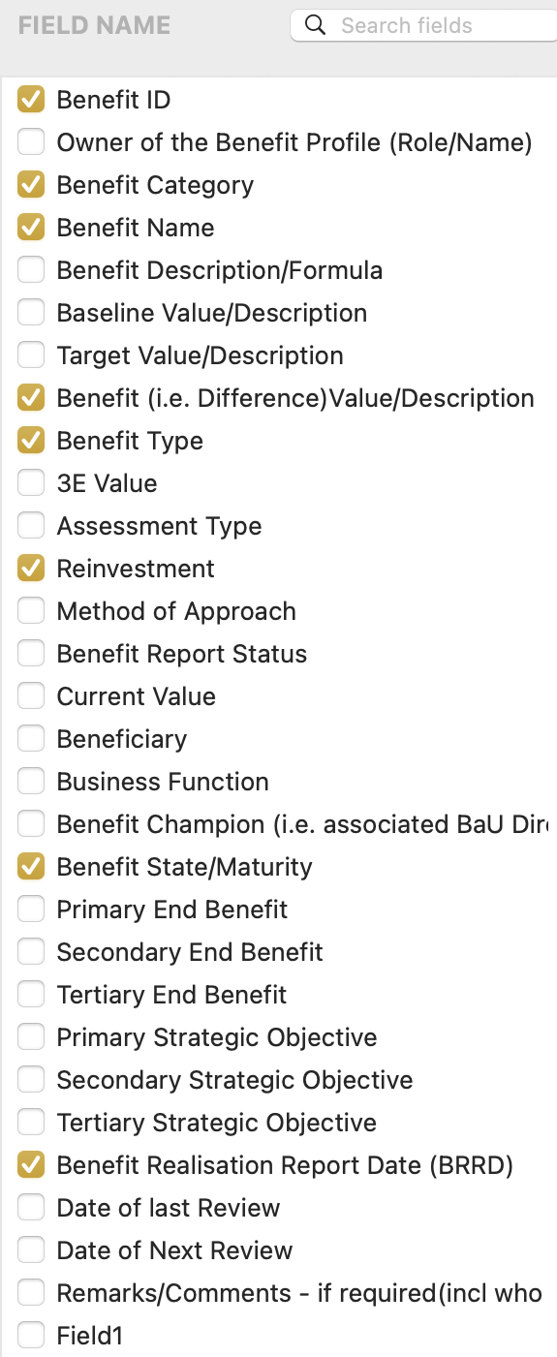
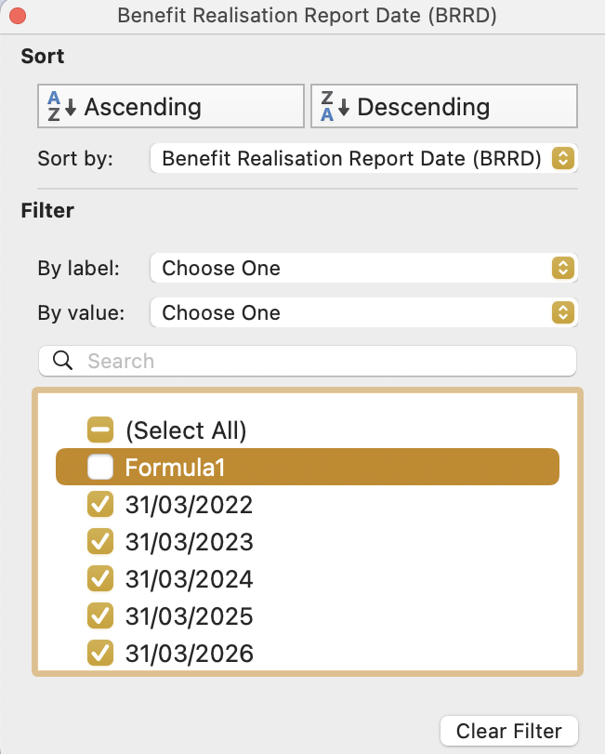
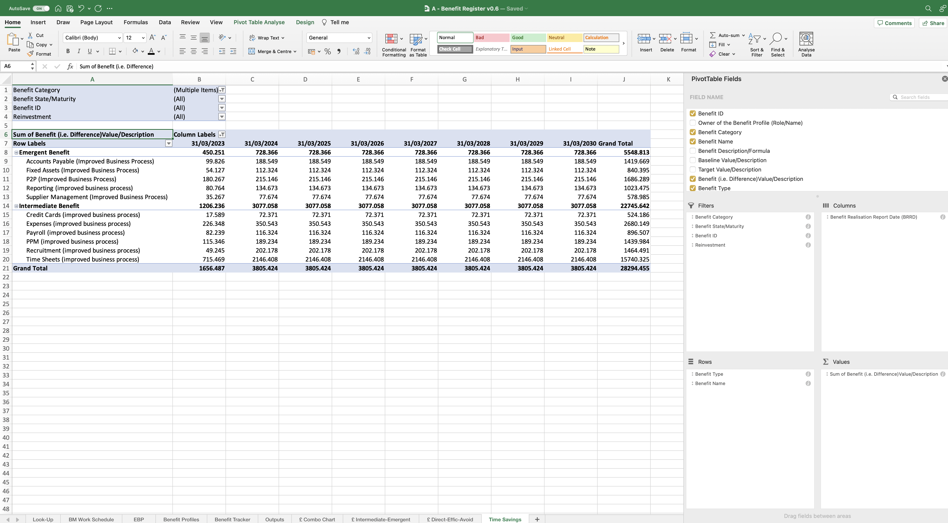
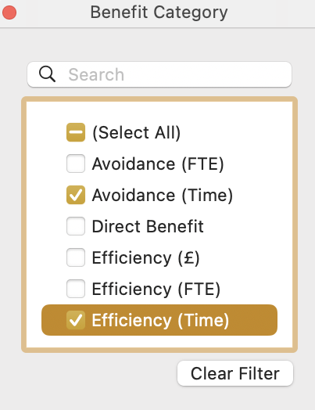
Image 87
3
Select the ‘Column Label’ drop-down icon, when this window appears, ensure only those fields with a date are selected.
2
Select the ‘Benefit Category’ drop-down icon, when the ‘Benefit Category’ window appears, ensure only the two time fields are selected.
Drag and drop the highlighted field names from the ‘Field Name’ group at the top, into the ‘Filters, Columns, Rows and Values’ fields at the bottom as shown.
When complete, the field name ‘Benefit (i.e. Difference/Value/Description)’ auto populates with the additional text ‘Sum of’, when it has been dropped into the ‘Values’ field. Allow that to happen – do nothing.
1

