Slide 1
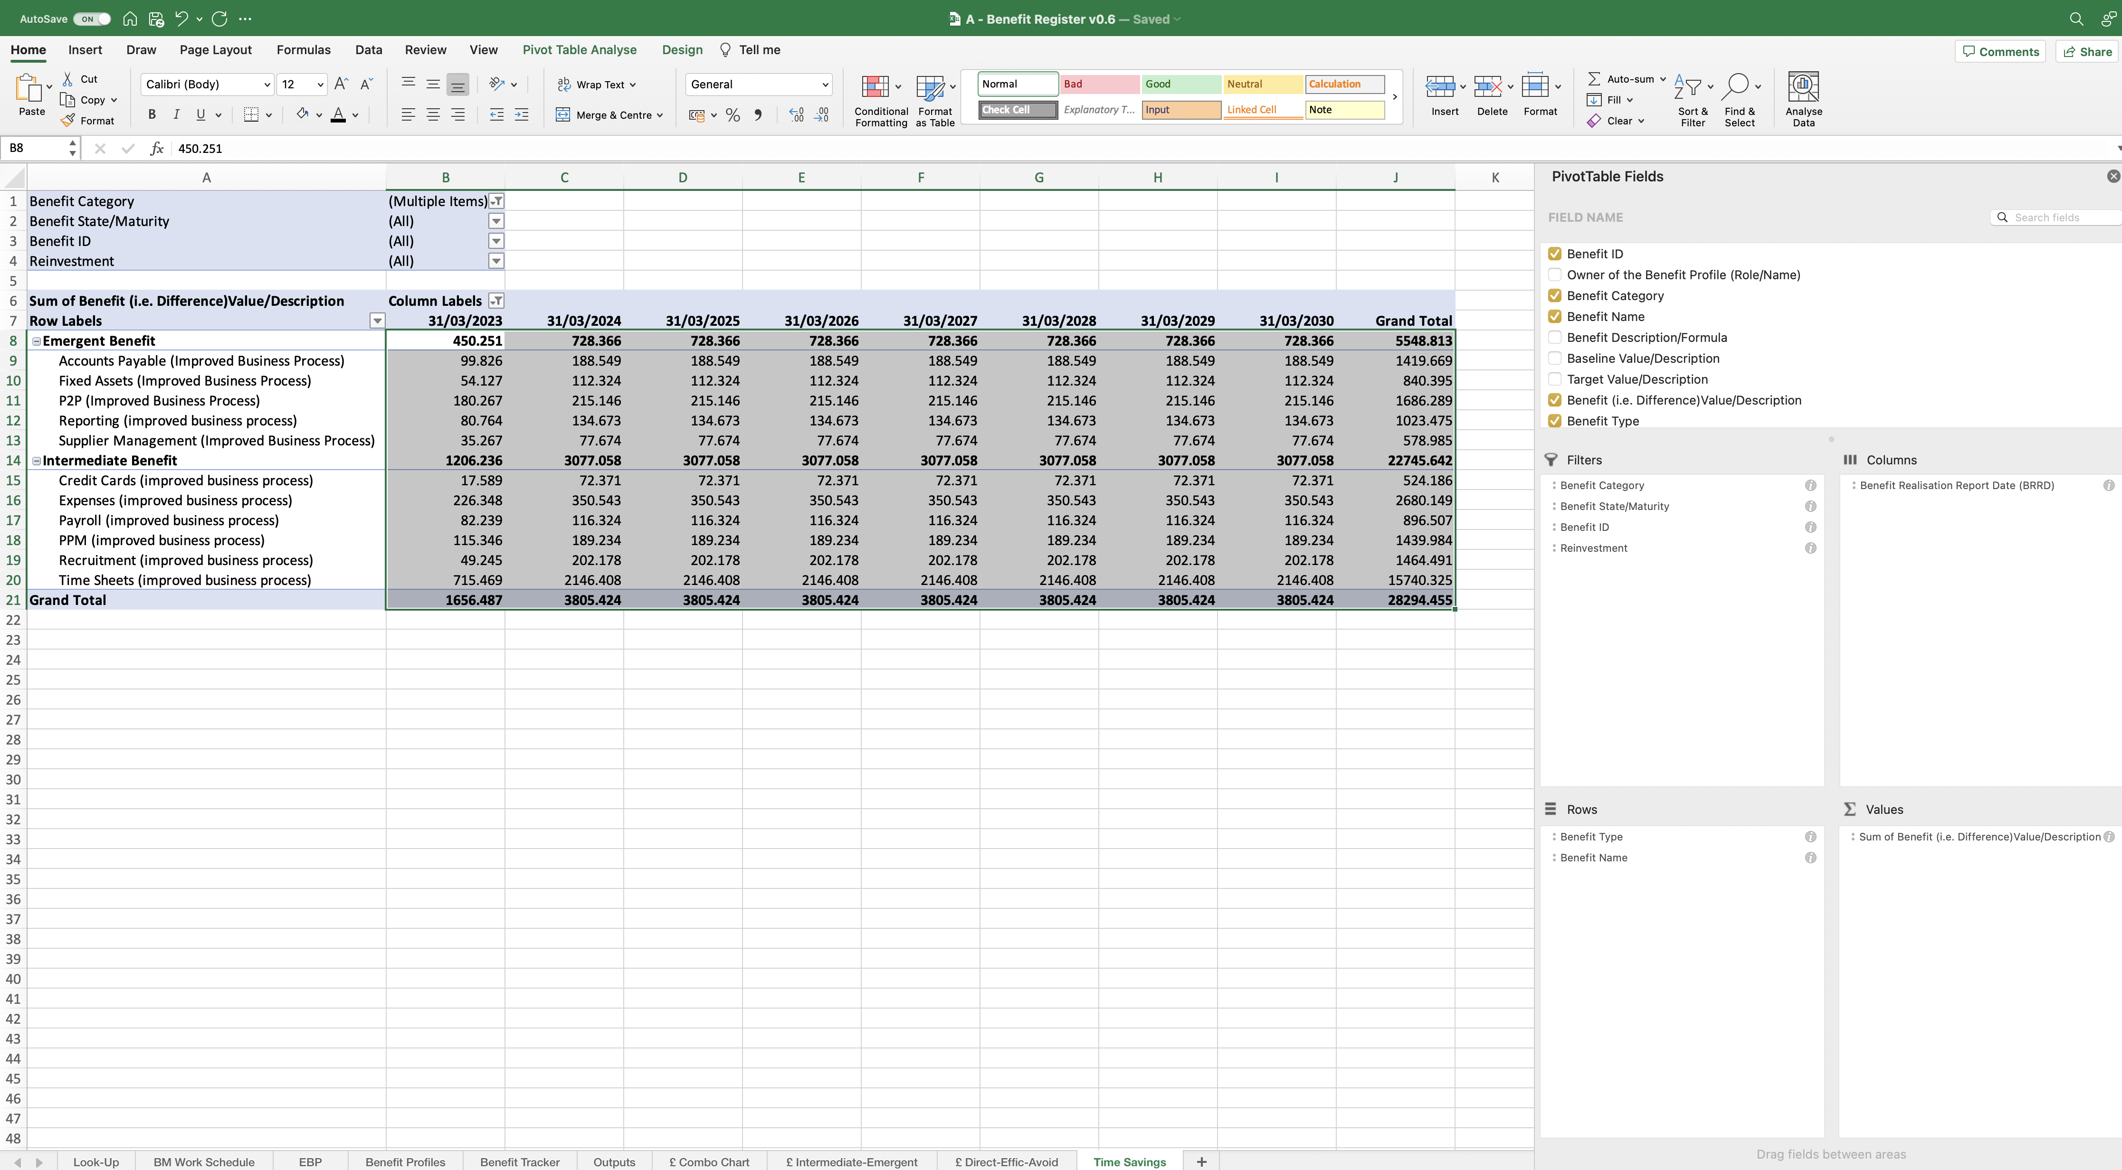
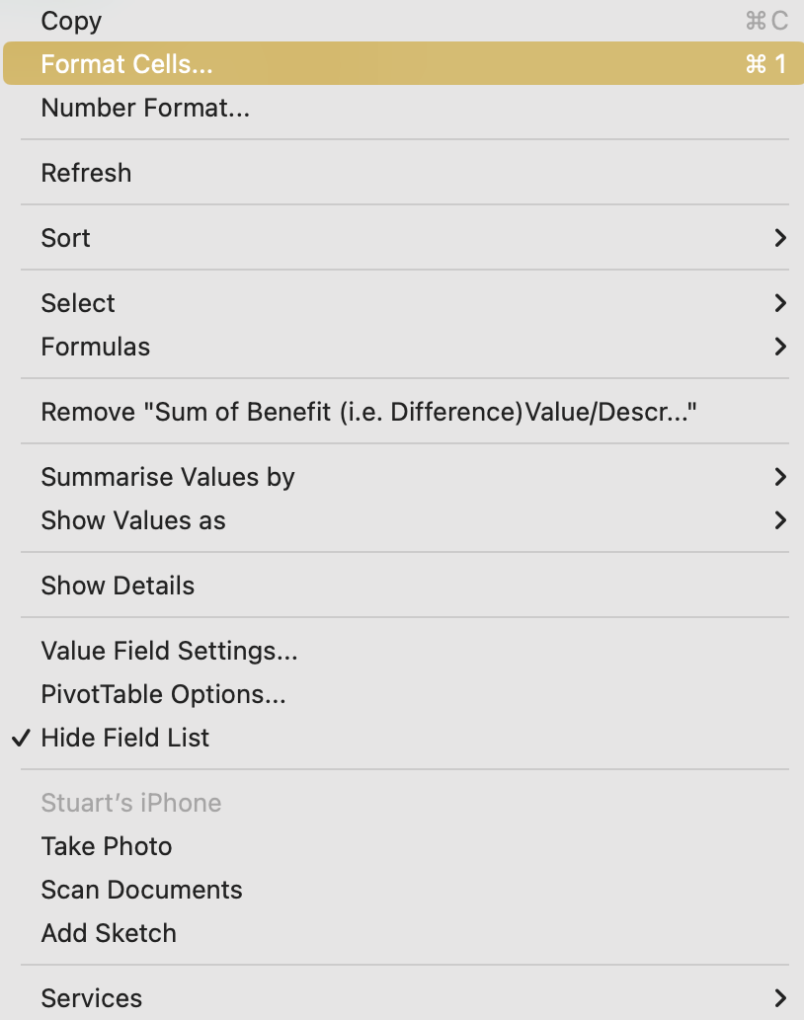
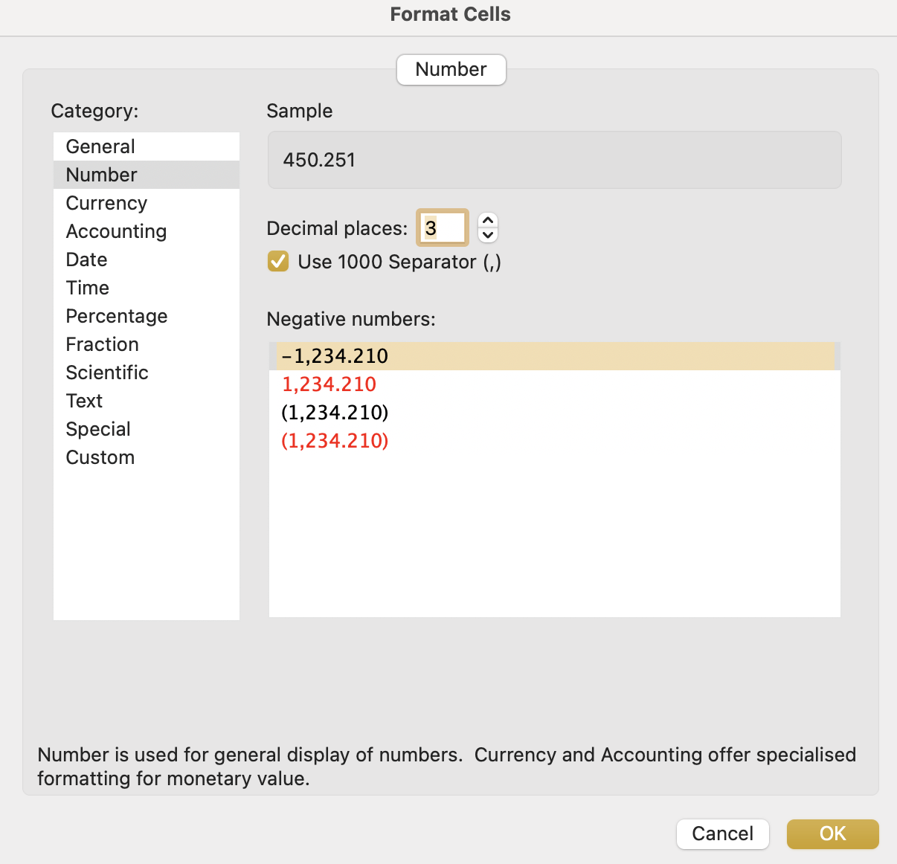
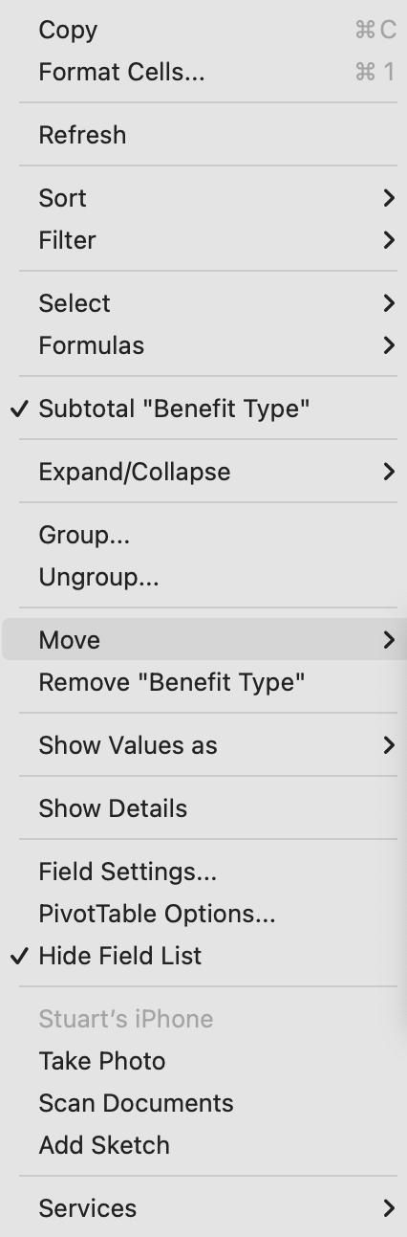
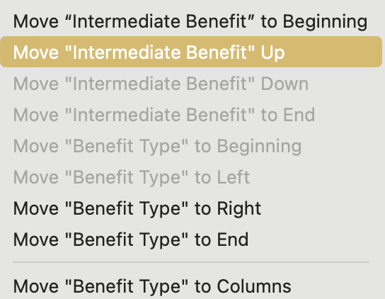
Image 88
Now we want to format these fields. Select all of them as shown, right click onto any one of them, then select ‘Format Cells’.
2
The ‘Format Cells’ window will appear. Select (a) ‘Currency’ (b) ‘3 Decimal Places’ (c) ‘£ Symbol’ (d) ‘4th option for Negative Numbers’ (e) ‘OK’.
1
3
Right click on the ‘Intermediate Benefit’ label, when this 1st window appears, select ‘Move’. When the second window appears, select ‘Move Intermediate Benefit Up’.
a
b
c
d
e

