Slide 1
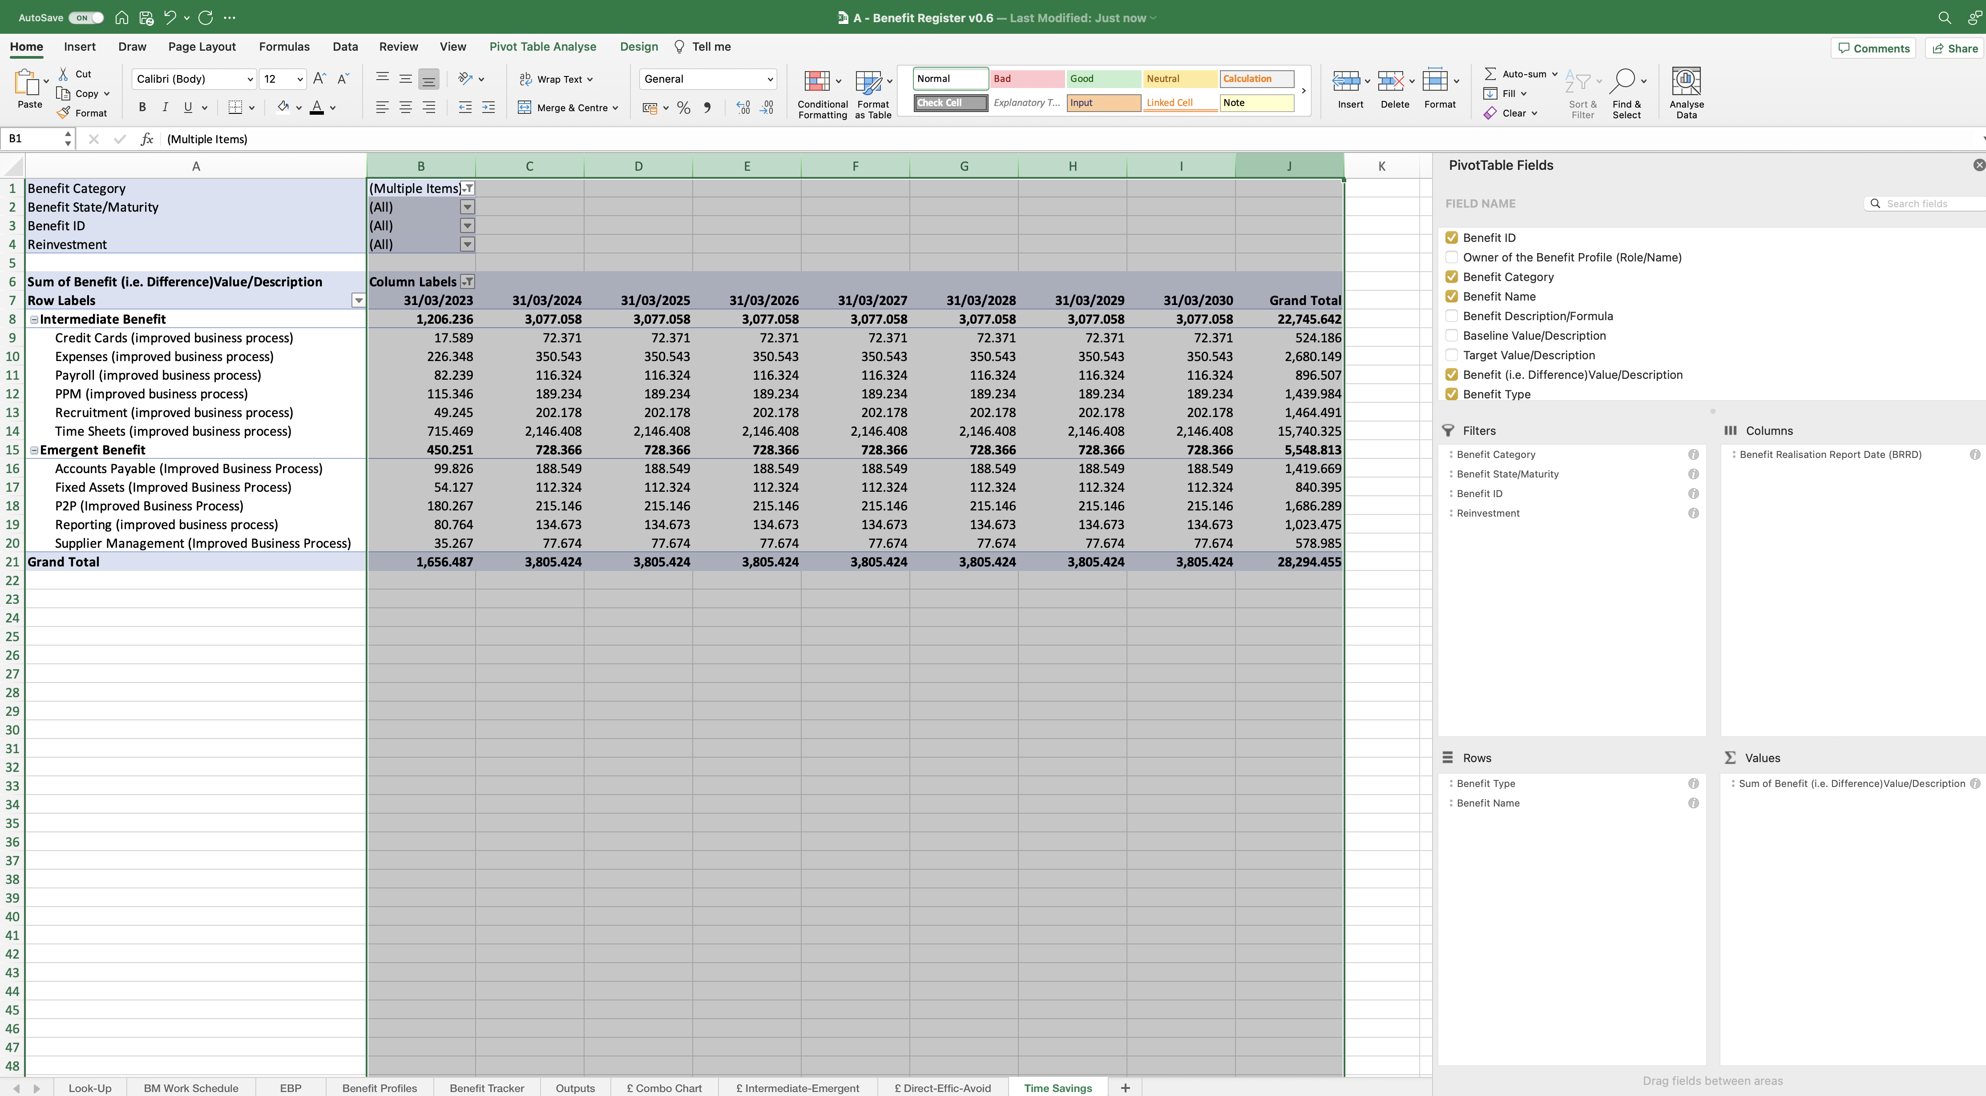
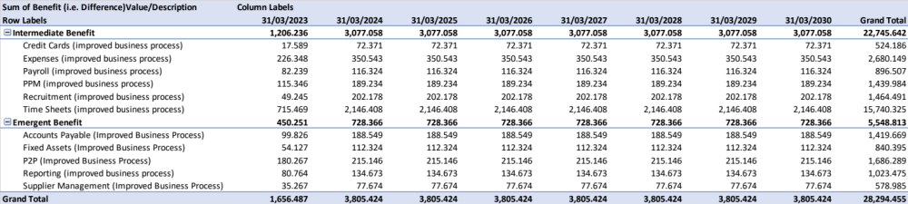
Image 89
The formatting is nearly complete. Select the columns as shown, then click/drag the column dividing line between the letters, so the width of each column is the same and, makes the PivotTable look presentable.
1
2
Align the heading text to the right.
The PivotTable should now look like this.
3

