Slide 1
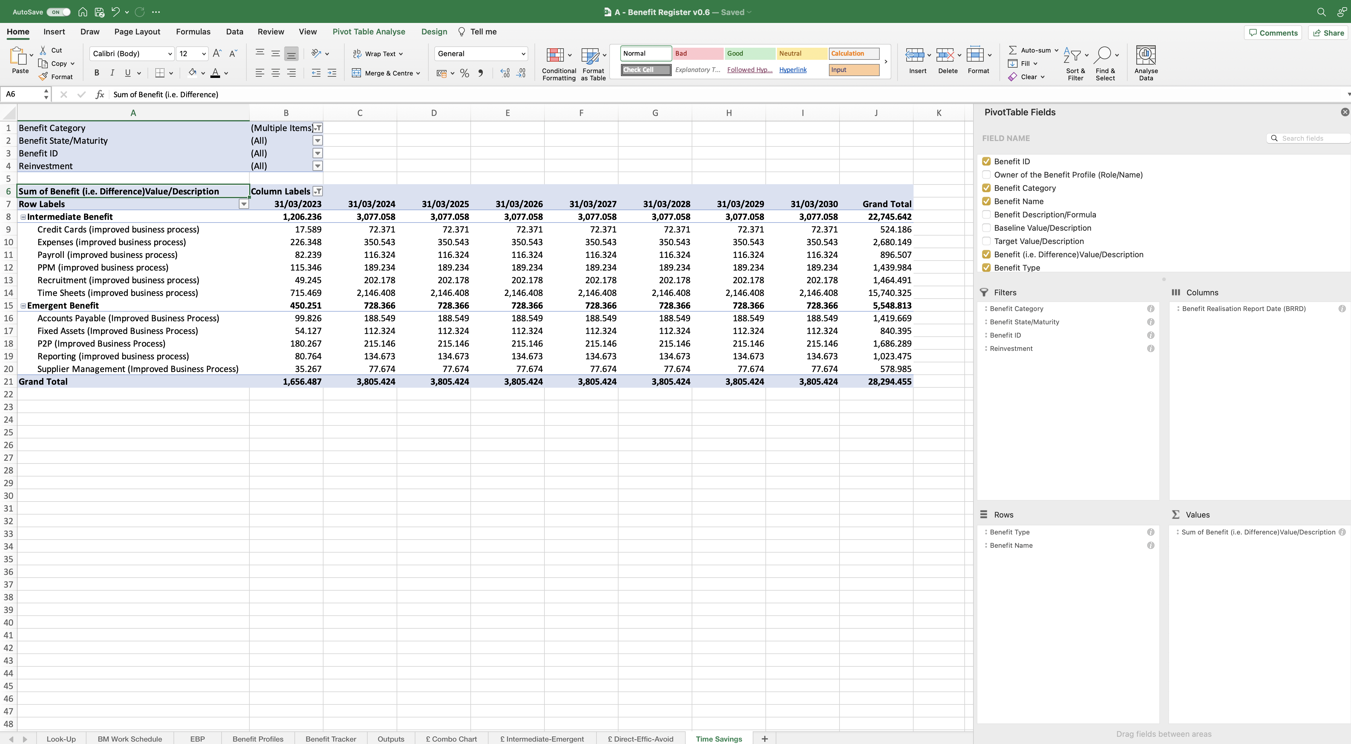
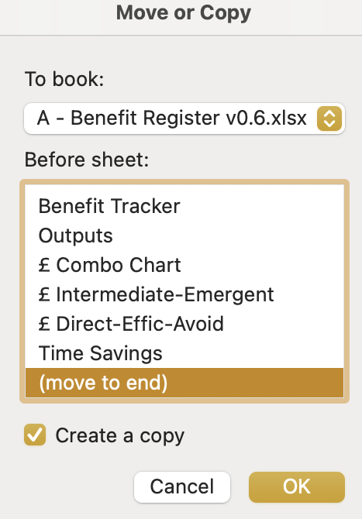
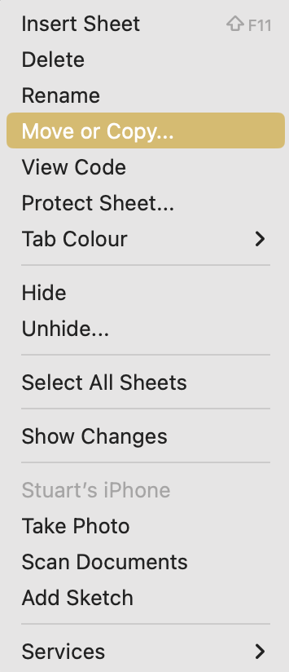
Image 90
Tip. Remember, the data in this PivotTable is pulled from the Benefit Profiles worksheet. When the Benefit Profiles are being updated, some Benefits may be reported to be ‘Cancelled’ in the Benefit State/Maturity column. The cancelled Benefits can be de-selected using the ‘Benefit Category’ drop-down icon.
You are now going to create the second PivotTable.
Tip: Select Yes or No from this field, to see what Time savings can or cannot be reinvested. See para 1.8.
Right click on the ‘Time Saving’ worksheet name, then select ‘Move or Copy’ when the window opens.
1
When the ‘Move or Copy’ window opens, scroll down the first box to find and select ‘(move to end)’. Select ‘Create a copy’. Select ‘OK’.
2

