Slide 1
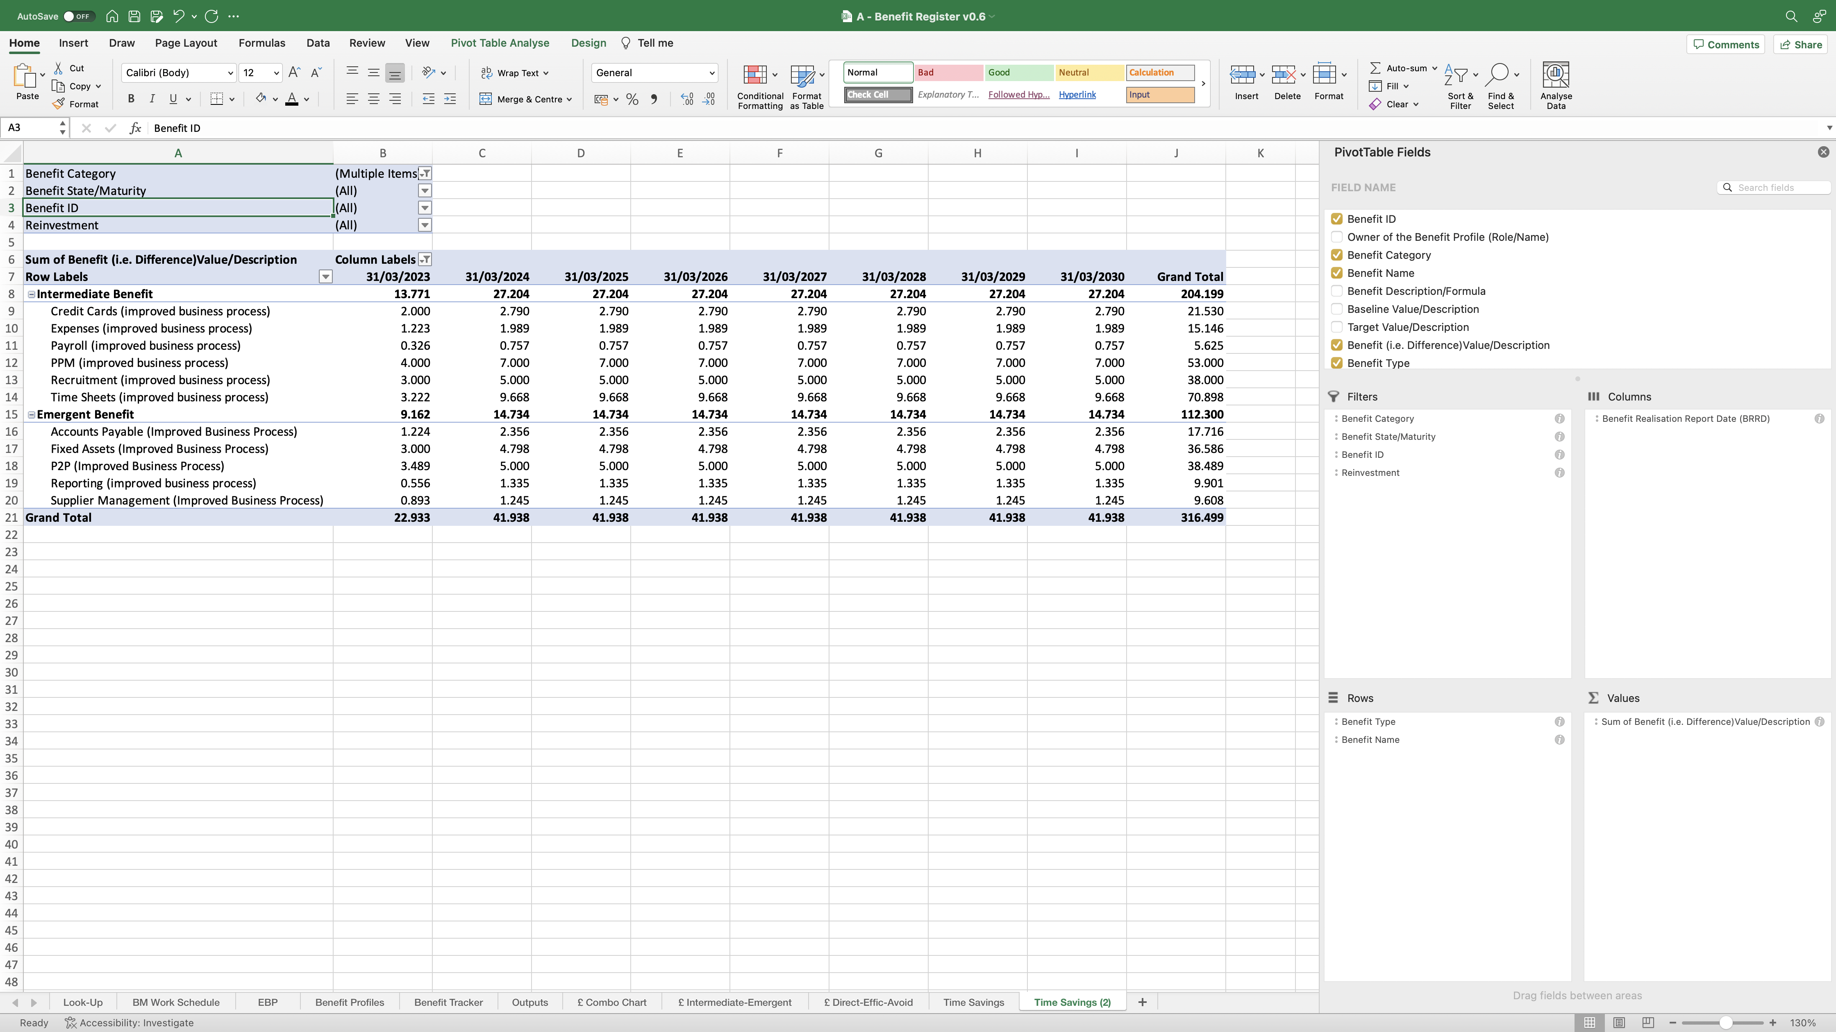
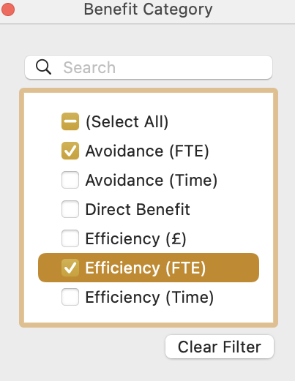
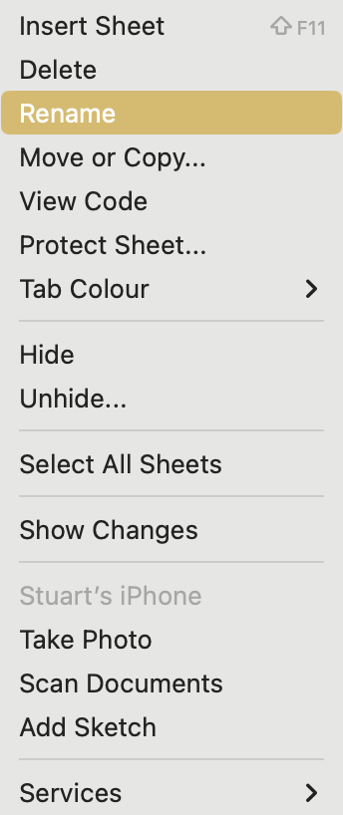
Image 91
Remember to adjust the width of each column (see image 89 step 1) to ensure the PivotTable looks presentable.
3
2
Select the ‘Benefit Category’ drop-down icon, when this window appears, de-select the 2 time fields, then select the FTE fields only.
Reminder: See para 1.7 reference FTE savings identified by a CI.
Right click on the ‘Time Saving (2)’ worksheet name, then select ‘Rename’ when the window on the right opens. Rename the worksheet ‘FTE Savings’.
1

