Slide 1
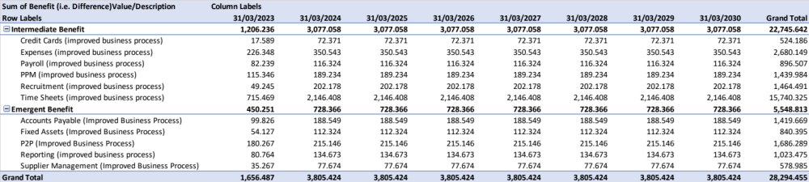
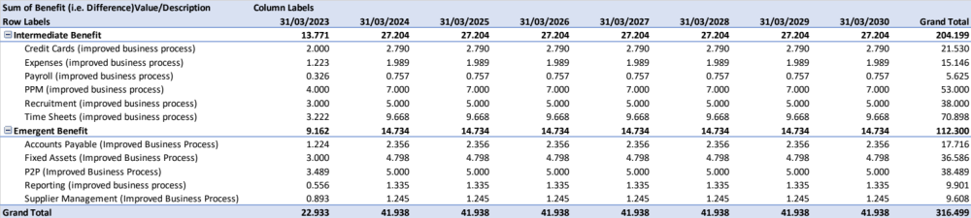
Image 92
The aggregated, low-level Intermediate/Emergent Benefits are used to inform and quantify the Efficiency End Benefits on the CI’s Benefit Map. See para 1.1.1.
Gross Intermediate/Emergent Time Savings across the life of the CI
End Benefit-01 (Time Savings):
Do something faster; less complicated; fewer steps in the process; resourceful; not wasting time.
FBC Target: 134,000 days.
Current value: 28,294.479 days.
Efficiency
Gross Intermediate/Emergent FTE Savings across the life of the CI
End Benefit-03 (FTE Savings):
Spare capacity; structured; organised; reinvestment; prioritisation; productivity; better use of resources.
FBC Target: 700 FTE.
Current value: 316.499 FTE.
Efficiency

