Slide 1
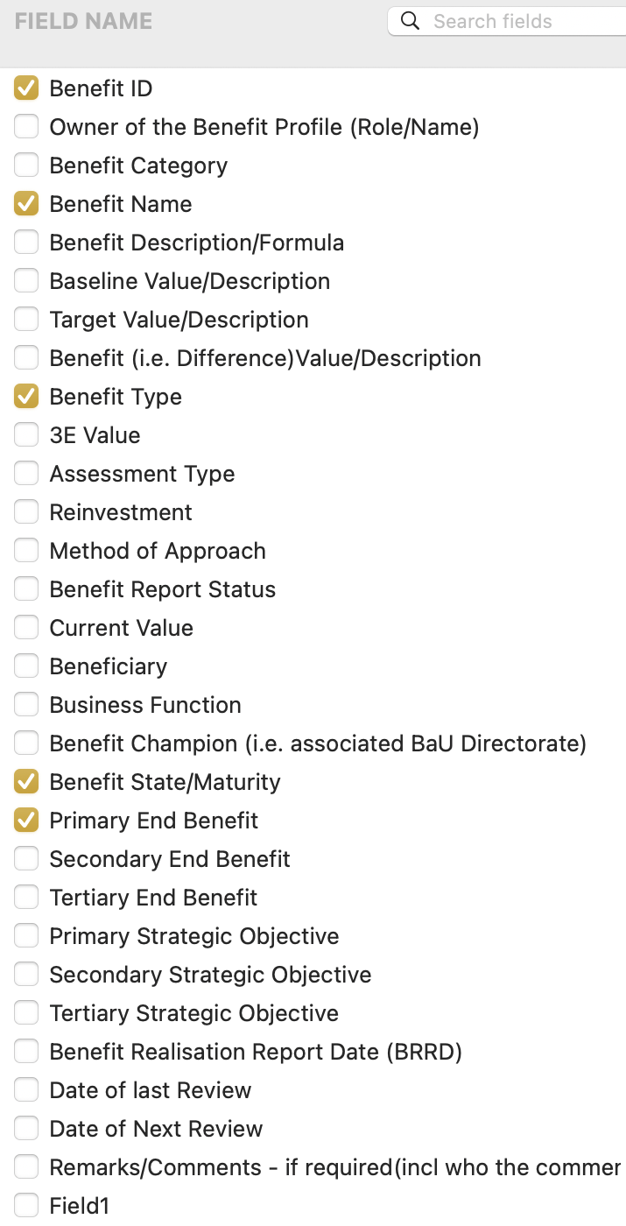
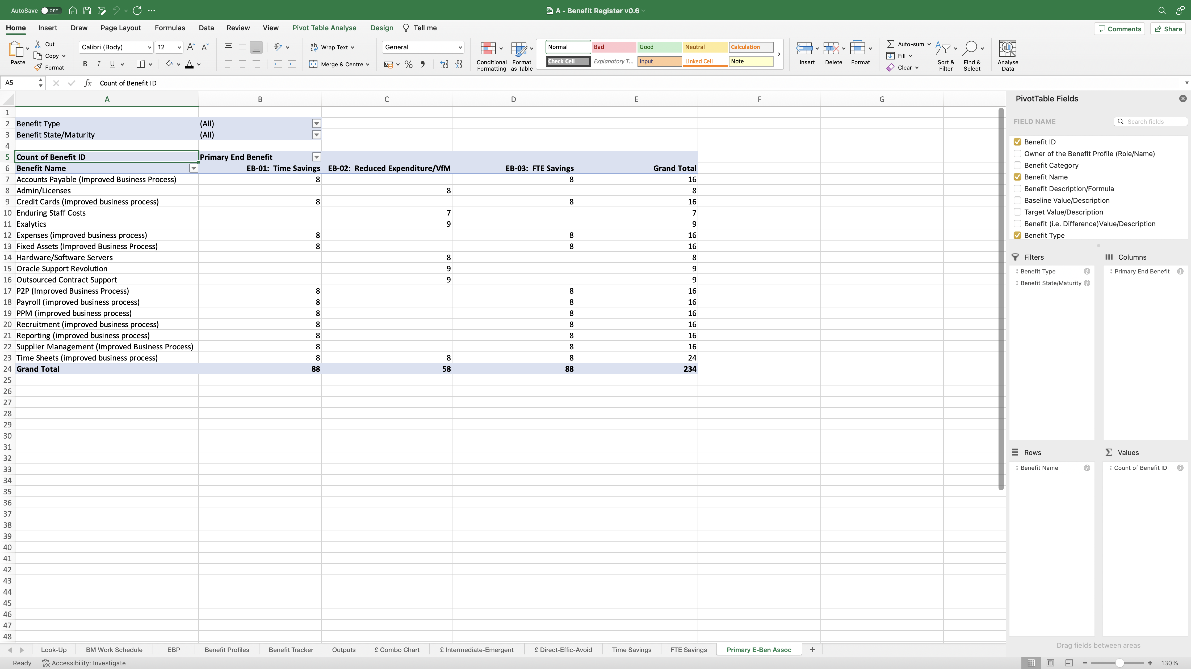
Image 95
2
Select columns B–E in this case (as shown previously – image 89, step 1), then click-dragging the column dividing line between the letters, so the width of each column is the same and, makes the PivotTable look presentable.
Drag and drop the highlighted field names from the ‘Field Name’ group at the top, into the ‘Filters, Columns, Rows and Values’ fields at the bottom as shown.
When complete, the field name ‘Benefit ID’, auto populates with the additional text ‘Count of’, when it has been dropped into the ‘Values’ field. Allow that to happen – do nothing.
Align the heading text to the right.
1
3
Tip. Remember, the data in this PivotTable is pulled from the Benefit Profiles worksheet. When the Benefit Profiles are being updated, some Benefits may be reported to be ‘Cancelled’ in the Benefit State/Maturity column. The cancelled Benefits can be de-selected using this drop-down field.

