Slide 1
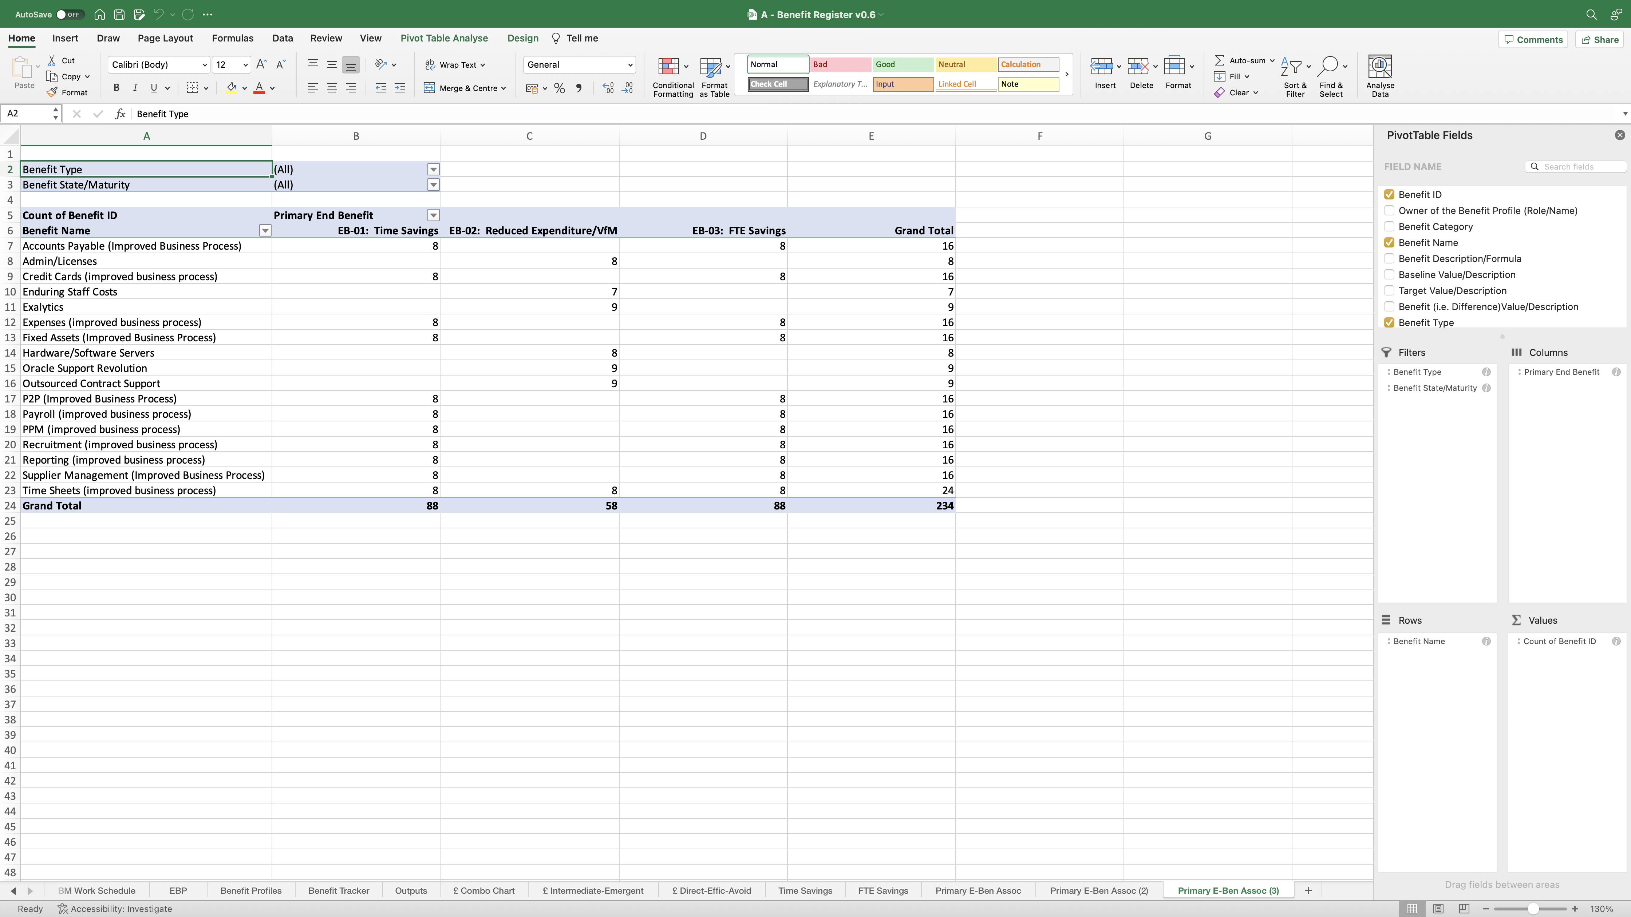
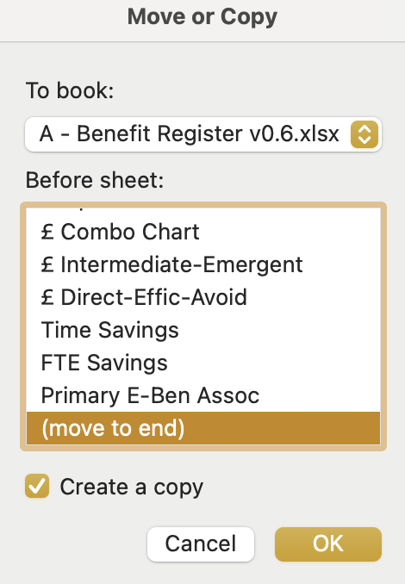
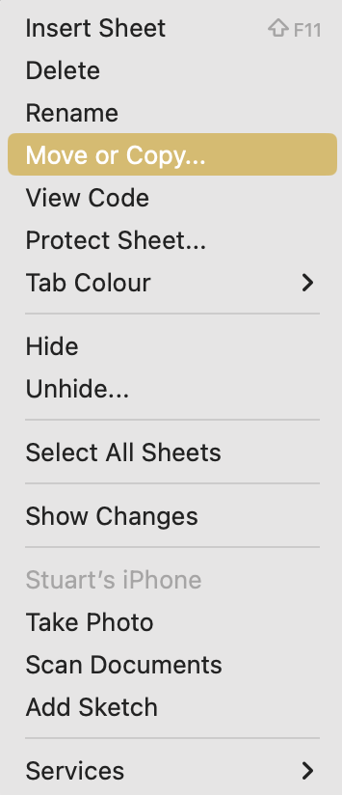
Image 96
You are now going to create the second and third PivotTables.
3
When complete, repeat steps 1 and 2 again to create a third PivotTable. The 2 copied worksheets are located here.
Right click on the ‘Primary E-Ben Assoc’ worksheet name, then select ‘Move or Copy’ when the window opens.
1
When the ‘Move or Copy’ window opens, scroll down the first box to find and select ‘(move to end)’. Select ‘Create a copy’. Select ‘OK’.
2
4
As learnt previously, rename the 2 copied worksheets as shown.
Rename to: ‘Secondary E-Ben Assoc’.
Rename to: ‘Tertiary
E-Ben Assoc’.

