Slide 1
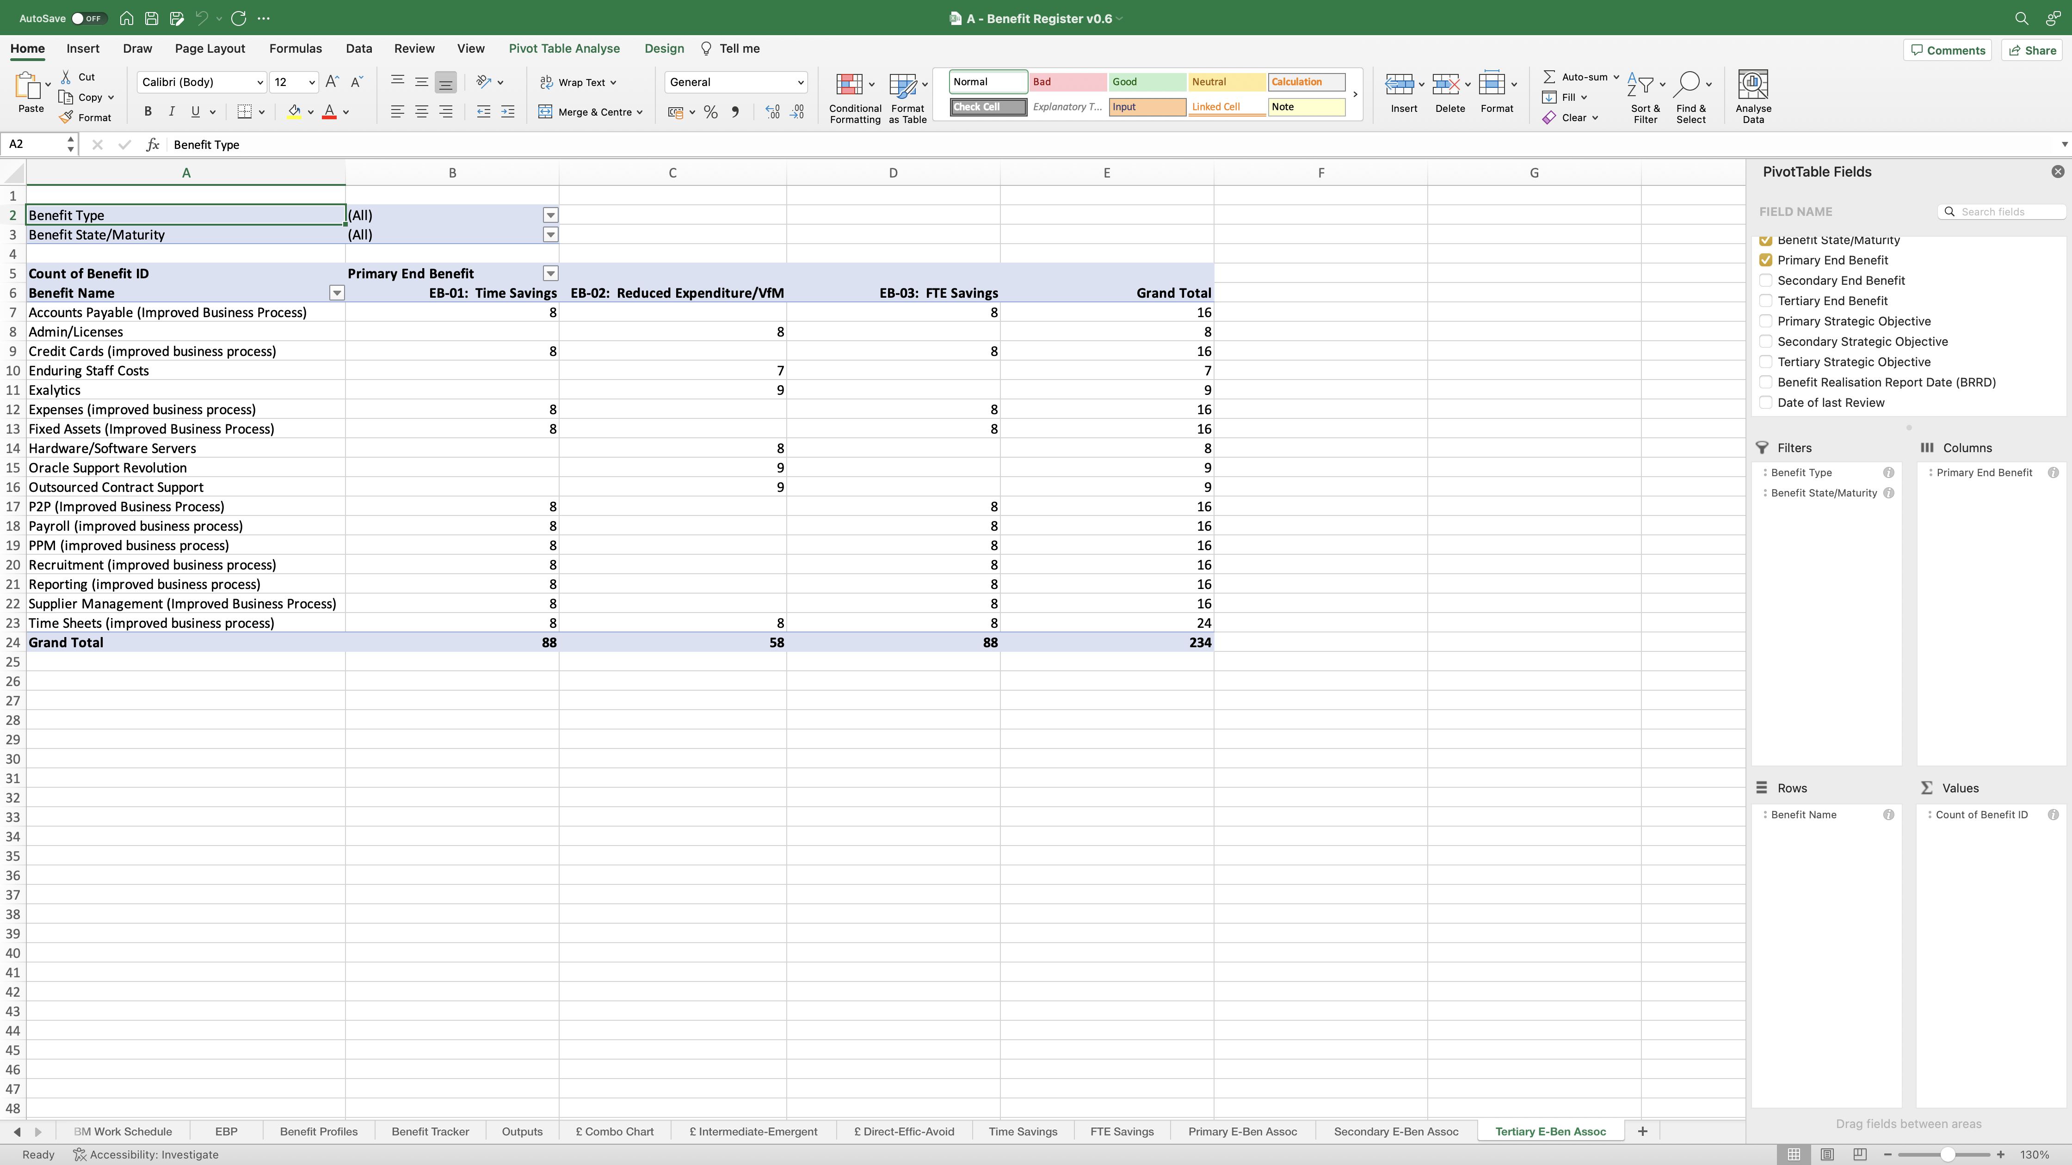
Image 98
Align the heading text to the right.
5
3
Drag the ‘Tertiary End Benefit’ into the ‘Columns’ Field.
2
Right click on the ‘Primary End Benefit’ then select ‘Remove Field’.
4
Re-align the columns as shown previously.
1
Edit the ‘Tertiary E-Ben Assoc’ worksheet.

