Slide 1
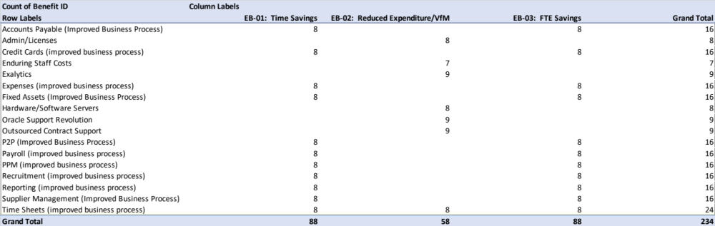
Image 99
Explanation: Remember – this information is pulled from the populated Benefit Profiles in the Benefit Profiles worksheet.
3
Have a primary, direct association with these End Benefits.
1
This is the ‘Primary End Benefit Association’ worksheet.
These Intermediate or Emergent Benefits
Using the blue box as an example, there are 8, year-on-year monetised Benefits in the Benefit Profiles worksheet named ‘Admin/Licenses’, that have been associated directly, with the CI’s Economic End Benefit No EB-02 ‘Reduced Expenditure/VfM’.
2
4

